Slide 1
Transformational Leadership – 101
Facilitating Groups
Notes:
Instruction:
Course is approximately 2 hours
Preparation needed for class:
Review roster of scheduled attendees
Before presenting this module refer to the Instructor/Leader Guide (put in the link) and familiarize yourself with the module materials, including speaker notes
Create the Poll Questions (review sections to see which items to include)
Open associated Skillport courses and videos before beginning class (reference Skillport and course/video IDs)
Obtain easel pad, pens/markers for documenting discussion
Print copies of Action Plan to handout (see References for location)
Take attendance, add/remove names on roster as needed
Say:
Welcome to the Facilitating Groups module in the 101 series. Through participation you will get more out of the program. In addition, there will be Job Aids and Skillbrief resource links provided for your reference.

Slide 2
Facilitation: Instructor Led Agenda
Objectives (5 minutes)
Chapter 1: Defining Facilitation
Chapter 2: Facilitation Foundation
Chapter 3: Facilitation Challenges
Break (10 minutes)
Chapter 4: Facilitation Techniques
Review
Notes:
Instructions:
No animation
Say:
The agenda for this module is – Objectives, Defining Facilitation, Facilitation Foundation, Facilitation Challenges, Facilitation Techniques, and Review

Slide 3
Facilitation: Objectives
Notes:
Instructions:
No animation
Say:
Objectives

Slide 4
Facilitation: Objectives
Explain the purpose and benefits
Recognize when to use
Describe common mistakes
Apply effective techniques
Notes:
Instructions:
4 Objectives total
First objective is visible
Mouse click for subsequent objectives to appear, and read the objectives
Say:
The objectives for this module are:
Explain the purpose and benefits
Recognize when to use
Describe common mistakes
Apply effective techniques

Slide 5
Defining Facilitation
Chapter 1: Defining Facilitation
Notes:
Instructions:
No animation
Say:
The first chapter is Defining Facilitation

Slide 6
Defining Facilitation: Discussion
Discussion points:
When you think of Facilitation, what comes to mind?
When you think of Facilitation, who comes to mind?
Notes:
Instructions:
First line and first bullet visible
2 Discussion questions total
Read first bullet and have group discussion
Mouse click for second bullet to appear
Read bullet and have group discussion
Get participants thinking about the concept of Facilitation…
Say:
When you think of Facilitation, what comes to mind?
[listen while the group provides answers]
When you think of Facilitation, who comes to mind?
[listen while the group provides answers]

Slide 7
Defining Facilitation: Formal Definition
“Enabling individuals or groups to successfully execute tasks while preserving integrity, dignity and empathy in the workplace.”¹
¹SkillSoft. Course: Using Facilitation Skills as a Manager. ID: mgmt_31_a01_bs_enus. Skillport. Retrieved July 22, 2015, from http://library.web.boeing.com/wsso/skillsoft.asp
Notes:
Instructions:
No animation
Read the definition
Say:
It is often helpful to start out with a formal definition. Facilitation is about enabling individuals or groups to successfully execute tasks while preserving integrity, dignity and empathy in the workplace.
Is there another definition you prefer?

Slide 8
Defining Facilitation: What It Is and Is Not
Facilitation Is: Facilitation Is Not:
Guiding others to develop their own objectives and solutions
Making a decision for the team
Emphasizing the journey
Rushing to the destination
Empowering people to take responsibility/ownership
Providing the answers
Descriptive
Prescriptive
Notes:
Instructions:
First line visible on chart
Each item appears with a mouse click
Read each item
Say:
What is Facilitation and what is it not?
Facilitation is guiding others to develop their own objectives and solutions
Facilitation is not leading
Facilitation is emphasizing the journey
Facilitation is not rushing to the destination
Facilitation is empowering people to take responsibility/ownership
Facilitation is not providing all the answers
Facilitation is descriptive
Facilitation is not prescriptive

Slide 9
Defining Facilitation: Who It is and Is Not
When we asked, “When you think of Facilitation, who comes to mind?”
If you didn’t think of yourself, this course is especially for you!
The skill of Facilitation should be a tool in your leadership toolbox
If you did think of yourself, this course is still for you!
Provides the opportunity to share or expand your knowledge
Facilitative Leadership Is For Everyone!
Notes:
Instructions:
First line visible
Mouse click for first bullet (sub-bullet comes in automatically)
Mouse click for second bullet (sub-bullet comes in automatically)
Read each bullet – emphasizing that Facilitative leadership is for everyone
Final mouse click – blue banner on bottom of slide will appear
Say:
When we asked earlier “When you think of Facilitation, who comes to mind?” If you did not think of yourself first, this course is especially for you! The skill of Facilitation is a tool that should be in your leadership toolbox. If you did think of yourself, this course is still for you. This course will allow you the opportunity to share or expand your knowledge on this subject.
Facilitative leadership is for everyone!

Slide 10
Defining Facilitation: Video
Video: Using Facilitation Skills as a Manager – What is Facilitation, 1 minute
Discussion questions:
What skills did Roger utilize to facilitate the conversation?
SkillSoft. Course: Using Facilitation Skills as a Manager. ID: mgmt_31_a01_bs_enus. Skillport. Retrieved July 22, 2015, from http://library.web.boeing.com/wsso/skillsoft.asp
Notes:
Instructions:
Show video on page 2 of “What is Facilitation” topic
Use discussion question with group afterwards
Discussion question appears on mouse click
Say:
Now we are going to view a short video focused on the concept of Facilitation. We will have discussion afterward.
What skills did Roger utilize to facilitate this conversation?
[Roger used his active listening skills with Anna. He helped her communicate her message, and in turn encouraged the group.]

Slide 11
Defining Facilitation: Video
Video: Using Facilitation Skills as a Manager – Facilitation Isn’t Easy, 1 minute
Discussion questions:
What Facilitation skills could Roger improve upon?
SkillSoft. Course: Using Facilitation Skills as a Manager. ID: mgmt_31_a01_bs_enus. Skillport. Retrieved July 28, 2015, from http://library.web.boeing.com/wsso/skillsoft.asp
Notes:
Instructions:
Show video on page 3 of “Intervening” topic
Use discussion question with group afterwards
Discussion question appears on mouse click
Say:
What Facilitation skills could Roger improve upon?
[Roger did not remain neutral and dominated the conversation. He dismissed all other suggestions and imposed his own solution. Facilitation requires acute observation skills and a light touch. He should have intervened only to redirect the process, if it went astray. Facilitation is not to push ideas, fix problems or propose solutions. However, this doesn’t mean you shouldn’t be part of the conversation. You should take an active role in order to keep the participants focused. Intervening means entering the conversation in order to stimulate a change, or to steer the group back on track if necessary.]

Slide 12
Facilitation Foundation
Chapter 2: Facilitation Foundation
Notes:
Instructions:
No animation
Say:
Facilitation Foundation

Slide 13
Facilitation Foundation: Discussion
Discussion points:
What are the benefits of proper Facilitation?
What skills are necessary for effective Facilitation?
Notes:
Instructions:
First line and bullet visible
Read bullet and have group discussion
Mouse click for second discussion question
Read bullet and have group discussion
Say:
What are the benefits of proper Facilitation?
[listen while the group provides answers]
What skills are necessary for effective Facilitation?
[listen while the group provides answers]

Slide 14
Facilitation Foundation: Benefits
Benefits of proper Facilitation:
Fosters healthy teams and participation
Builds individual and team skills
Empowers people to take responsibility/ownership
Enables people to collaborate in making complex decisions
Encourages more informed decision-making
Satisfies the needs of the group (not just the majority)
Achieves commitment and sustainable agreements
Facilitators Empower People…Nurture Leadership Talent!
SkillSoft. Course: Using Facilitation Skills as a Manager. ID: mgmt_31_a01_bs_enus. Skillport. Retrieved July 22, 2015, from http://library.web.boeing.com/wsso/skillsoft.asp
Notes:
Instructions:
First line visible
Each benefit appears with a mouse click
Read each benefit
Final mouse click – blue banner on bottom of slide will appear
Say:
There are benefits to proper Facilitation:
Fosters healthy teams and participation (more unified culture where everyone participates)
Builds individual and team skills
Empowers people to take responsibility/ownership (nurtures leadership talent)
Enables people to collaborate in making complex decisions
Encourages more informed decision-making
Satisfies the needs of the group (not just the majority)
Achieves commitment and sustainable agreements
Facilitators Empower People…Nurture Leadership Talent!

Slide 15
Facilitation Foundation: Facilitator Values
Successful facilitators embrace these values:
People are smart and like to do the right thing
Mutual understanding and respect are essential
Everyone’s input has merit, regardless of seniority or title
People can take ownership, and are accountable for their performance
Facilitator’s Goal: Get Optimum Engagement From Each Team Member!
SkillSoft. Course: Using Facilitation Skills as a Manager. ID: mgmt_31_a01_bs_enus. Skillport. Retrieved July 22, 2015, from http://library.web.boeing.com/wsso/skillsoft.asp
Notes:
Instructions:
First line visible
Each value appears with a mouse click
Read each value
Final mouse click – blue banner on bottom of slide will appear
Say:
Successful facilitators embrace these values:
People are smart and like to do the right thing
Mutual understanding and respect are essential
Everyone’s input has merit, regardless of seniority or title
People can take ownership, and are acc for their performance
Facilitator’s Goal: Get Optimum Engagement from Each Team Member!

Slide 16
Facilitation Foundation: Skills of Successful Facilitator
“Process” Skills:
Problem Solving Model: Recognize/utilize methodology to resolve issue
Problem Solving Phase: Identify/explain phases to resolve issue
Problem Solving Step: Identify/explain/guide team to resolve issue
“People” Skills:
Active Listening: Demonstrating interest by your body language
Building Rapport: Establishing credibility to enable people to contribute with ease
Communicating Effectively: Being supportive and engaged to enable an open and safe environment
Questioning Techniques: Utilizing questions to check understanding, ask for clarification or expand a view
W
M
Must Master Both Skills To Be Successful!
Notes:
Instructions:
First line visible
Each item appears with a mouse click
Read each bullet
Final mouse click – blue banner on bottom of slide will appear
Say:
In order to be a successful Facilitator, you must master certain skills. Those skills are focused on the “process” as well as “people”.
“Process Skills”:
Problem Solving Model: Recognize/utilize methodology to resolve issue
Problem Solving Phase: Identify/explain phases to resolve issue
Problem Solving Step: Identify/explain/guide team to resolve issue
“People Skills”:
Active Listening: Demonstrating interest by your body language
Building Rapport: Establishing credibility to enable people to contribute with ease
Communicating Effectively: Being supportive and engaged to enable an open and safe environment
Questioning Techniques: Utilizing questions to check understanding, ask for clarification or to expand a view
You must master both skills in order to be successful!

Slide 17
Facilitation Foundation: What Did You Learn?
Knowledge Check questions are from Skillport. Using Facilitation Skills as a Manager. Retrieved July 28, 2015.
Notes:
Instructions:
Read each question
Mouse click to reveal the answers to choose from
Group chooses the appropriate answer(s)
Mouse click to show the answer
Say:
Knowledge Check

Slide 18
Facilitation Foundation: What Did You Learn?
Question:
What are some specific benefits of adopting a Facilitative approach?
Choose more than one option.
Empowers people to take responsibility; nurtures leadership talent
Team members all agree on the selected solution
Fosters healthy team dialogue and participation
Team works better together to make complex decisions
Projects always completed on time
Answer: #1, #3, #4
Notes:
Instructions:
Read the question
Potential answers appear on mouse click
Answer appears on mouse click
Say:
Question: What are some specific benefits of adopting a Facilitative approach?
[mouse click]
Choose more than one option.
Empowers people to take responsibility; nurtures leadership talent
Team members all agree on the selected solution
Fosters healthy team dialogue and participation
Team works better together to make complex decisions
Projects always completed on time
[mouse click]
Answer:
#1-Empowers people to take responsibility; nurtures leadership talent
#3-Fosters healthy team dialogue and participation
#4-Team works better together to make complex decisions
Note: #2 answer is not correct. Team members will not always agree on the selected solution. It is important that all have equal input and discussion around the proposed solution. However, not everyone will always agree on solution going forward. More importantly, the individual must support whatever final team decision is made.
Allowing group discussion is optional

Slide 19
Facilitation Foundation: What Did You Learn?
Question:
What are the values Facilitators embrace?
Choose more than one option.
Telling others what to think and do
Helping people work effectively
Achieving optimum engagement from people
Value of participant input determined by who is speaking
Building confidence and accountability
Answer: #2, #3, #5
Notes:
Instructions:
Read the question
Potential answers appear on mouse click
Answer appears on mouse click
Say:
Question: What are the values Facilitators embrace?
[mouse click]
Choose more than one option.
Telling others what to think and do
Helping people work effectively
Achieving optimum engagement from people
Value of participant input determined by who is speaking
Building confidence and a sense of duty
[mouse click]
Answer:
#2-Helping people work effectively
#3-Achieving optimum engagement from people
#5-Building confidence and a sense of duty
Allowing group discussion is optional

Slide 20
Facilitation Challenges
Chapter 3: Facilitation Challenges
Notes:
Instructions:
No animation
Say:
Facilitation Challenges

Slide 21
Facilitation Challenges: Discussion
Discussion points:
When problem solving:
What process challenges have you encountered?
What team behavioral challenges have you encountered?
What Facilitator behavioral challenges have you encountered?
Notes:
Instructions:
First two lines visible
3 Discussion questions
Mouse click to have each of the discussion questions appear, read question, have group discussion
Say:
When problem solving:
What process challenges have you encountered?
[listen while the group provides answers]
What team behavioral challenges have you encountered?
[listen while the group provides answers]
What Facilitator behavioral challenges have you encountered?
[listen while the group provides answers]

Slide 22
Facilitation Challenges: Team Behaviors (“The Bad”)
Not Knowing Process
Unaware of problem solving methodologies, phases and steps to resolve issue
Not Following Process
Deviating from problem solving process to resolve issue
Straying from original purpose
Not Able to Guide Team Through Process
Lack of facilitative leadership skill/experience to help team resolve issue
Stating Assumptions as Facts
Drawing conclusions based on lack of data or mistakes
Stating absolute (e.g., always, never)
Manipulating Outcome
Preconceived ideas prior to meeting
Individuals holding hidden agendas
Emotions/Objections
Anger, defensiveness, silence, hostility
Disagreement on content, process or outcome
Dominating Conversation/Intervening at Wrong Time
One or more individuals controlling the conversation
Getting involved too early/too late
Not Knowing Process
P
R
O
C
E
S
S
Not Following Process
Not Able to Guide Team Through Process
Stating Assumptions as Facts
P
E
O
P
L
E
Manipulating Outcome
Emotions/Objections
Dominating Conversation/ Intervening at Wrong Time
SkillSoft. Course: Using Facilitation Skills as a Manager. ID: mgmt_31_a01_bs_enus. Skillport. Retrieved July 28, 2015, from http://library.web.boeing.com/wsso/skillsoft.asp
Notes:
Instructions:
Left side of chart is visible
Chart builds on right with each mouse click
Read each bullet
Say:
There are challenges that need to be overcome with Facilitation. These involve both “Process” and “People” issues. We will first look at challenges associated with team behaviors.
Not knowing the process is a team behavioral challenge. The individual(s) may be unaware of problem solving methodologies, the phases and/or steps needed to resolve the issue.
On the other hand, the individual or team may know the process, but do not follow it. They may understand the process, however deviate from the problem solving methodology in order to resolve an issue. Or, they may stray from their original purpose.
The last “process” challenge we will discuss is not being able to guide the team through the Facilitation process. Lack of facilitative leadership skills and/or experiences can be a challenge to resolving an issue.
The first challenge associated with “people” is the participant that states assumptions as facts. This means that they draw conclusions based on lack of data or based on mistakes. It can also come into play when someone states absolutes, such as using the words “always” or “never”.
Another challenge is the participant(s) that manipulates the outcome. They may bring in preconceived ideas to the meeting. It can also relate to an individual who holds hidden agendas.
The third challenge relates to the emotions and objections of the team members. Emotions may be anger, defensiveness, silence or hostility. The individual may also disagree on the content, process or outcome of the meeting/workshop.
The fourth challenge is the individual(s) who dominates the conversation and/or intervenes at the wrong or inappropriate time. We typically see this behavior when one or more individuals try and control the conversation. In addition, sometimes an individual can get involved in the conversation too early or too late.

Slide 23
Facilitation Challenges: Facilitator Behaviors (“The Ugly”)
Not Knowing Process
Unaware of problem solving methodologies, phases and steps to resolve issue
Not Following Process
Deviating from problem solving process to resolve issue
Straying from original purpose
Not Able to Guide Team Through Process
Lack of facilitative leadership skill/experience to help team resolve issue
Stating Assumptions as Facts
Drawing conclusions based on lack of data or mistakes
Stating absolute (e.g., always, never)
Manipulating Outcome
Preconceived ideas prior to meeting
Individuals holding hidden agendas
Emotions/Objections
Anger, defensiveness, silence, hostility
Disagreement on content, process or outcome
Dominating Conversation/Intervening at Wrong Time
One or more individuals controlling the conversation
Getting involved too early/too late
Not Knowing Process
P
R
O
C
E
S
S
Not Following Process
Not Able to Guide Team Through Process
Stating Assumptions as Facts
P
E
O
P
L
E
Manipulating Outcome
Emotions/Objections
Dominating Conversation/ Intervening at Wrong Time
SkillSoft. Course: Using Facilitation Skills as a Manager. ID: mgmt_31_a01_bs_enus. Skillport. Retrieved July 28, 2015, from http://library.web.boeing.com/wsso/skillsoft.asp
Notes:
Instructions:
Left side of chart is visible
Chart builds on right with each mouse click
Read each bullet
Say:
As we discussed in the previous slide, there are challenges that need to be overcome with Facilitation. Again, these involve both “Process” and “People” issues. We will now take a look at issues surrounding Facilitator behaviors.
Not knowing the process is a Facilitator behavioral challenge. The individual may be unaware of problem solving methodologies, the phases and/or the steps needed to resolve the issue.
On the flip side, is not following the process. The individual may know the process, however deviate from the problem solving methodology in order to resolve an issue. Or, they may stray from their original purpose.
The last challenge we will discuss is not being able to guide the team through the Facilitation process. Lack of facilitative leadership skills and/or experiences can be a challenge to resolving an issue.
The first “people” challenge is the individual that states assumptions as facts. This means that they draw conclusions based on lack of data or based on mistakes. It can also come into play when someone states absolutes, such as using the words “always” and “never”.
Another challenge is the individual that manipulates the outcome. They may bring in preconceived ideas to the meeting. It can also relate to an individual who holds a hidden agenda.
The third challenge relates to emotions and objections. Emotions may be anger, defensiveness, silence or hostility. The individual may also disagree on the content, process or outcome of the meeting/workshop.
The fourth challenge is an individual who dominates the conversation and/or intervenes at the wrong or inappropriate time. We typically see this behavior when an individual tries to control the conversation. In addition, sometimes an individual can get involved in the conversation too early or too late.

Slide 24
Facilitation Challenges: Facilitator Behaviors (“The Good”)
Not Knowing Process
Memorize common elements of problem solving models
Not Following Process
Recognize deviation from the process
Quickly redirect back to agreed to process
Not Able to Guide Team Through Process
Apply appropriate techniques to advance to next phase/step of problem solving model
Stating Assumptions as Facts
Gather facts before forming conclusions
Eliminate using absolutes; enabling more persuasive speech (e.g., frequently, sometimes)
Manipulating Outcome
Suppress preconceived opinions and ideas; be conscious of individuals with hidden agendas
Emotions/Objections
Be aware of harmful emotions (e.g., anger, silence, defensiveness) and address if needed
Clarify individual’s objection, remain neutral, respond to only core issue, gain agreement to move forward
Dominating Conversation/Intervening at Wrong Time
Call on other individuals; limit time of dominant individual
Let team attempt to work through issue before assisting
Not Knowing Process
P
R
O
C
E
S
S
Not Following Process
Not Able to Guide Team Through Process
Stating Assumptions as Facts
P
E
O
P
L
E
Manipulating Outcome
Emotions/Objections
Dominating Conversation/ Intervening at Wrong Time
SkillSoft. Course: Using Facilitation Skills as a Manager. ID: mgmt_31_a01_bs_enus. Skillport. Retrieved July 28, 2015, from http://library.web.boeing.com/wsso/skillsoft.asp
SkillSoft. Course: Using Facilitation Skills as a Manager. ID: mgmt_31_a01_bs_enus. Skillport. Retrieved July 28, 2015, from http://library.web.boeing.com/wsso/skillsoft.asp
24
Notes:
Instructions:
Left side of chart is visible
Chart builds on right with each mouse click
Read each bullet
Say:
As a skilled Facilitator, there are ways to overcome the challenges that you may encounter with an individual or a team. In the next section, we will discuss detailed techniques on ways to overcome these challenges; however for now, we will provide a brief overview on how to mitigate these “process” and “people” issues.
In order to solve the challenge of not knowing the process, memorize the common elements of the problem solving models.
Recognize if you are deviating from the process. If the process is not being followed, quickly redirect back to the agreed to process.
In order to effectively guide the team through the process, apply appropriate techniques to advance to the next phase/step of the problem solving model.
In order to overcome the challenge of individuals stating assumptions as facts, you can request that facts are gathered before forming any conclusions. Be mindful of individuals stating absolutes. In order to eliminate the behavior, you can encourage more persuasive speech, such as saying “frequently” or “sometimes”, in lieu of “never”.
You can suppress preconceived opinions and ideas to avoid manipulating the outcome of a meeting/conversation/workshop, etc… Everyone needs to be conscious of individuals with hidden agendas.
We should always be aware of our emotions, especially harmful ones such as anger, silence or defensiveness. If these emotions occur, address them and not avoid them.
In order to avoid dominating the conversation or intervening at the wrong time, be sure to call on other individuals. Limit the time that a dominant individual speaks. Also, let the team attempt to work through the issue first, before jumping in to assist.

Slide 25
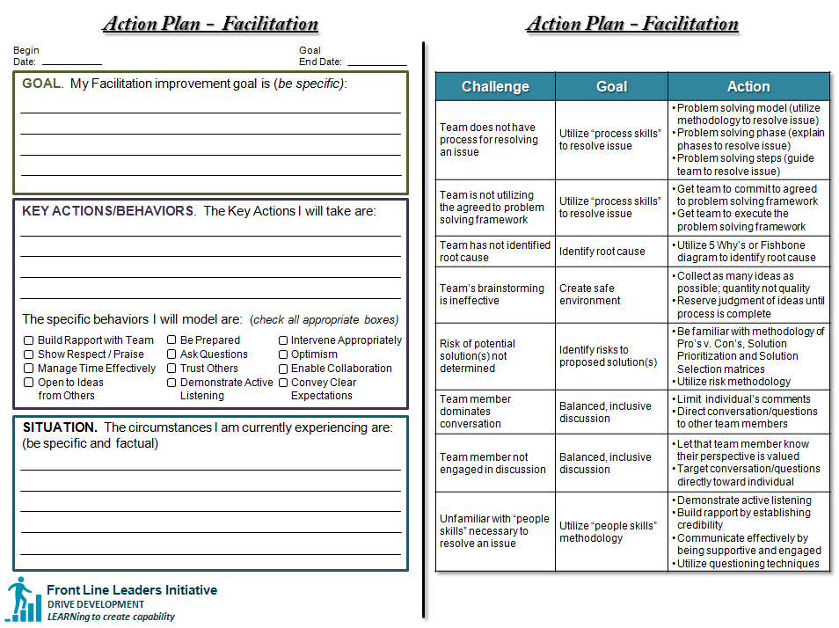
Facilitation Challenges: Action Plan
Notes:
Instructions:
Review on screen the Action Plan – Facilitation, why you use it, how to use it (the next slide is when the hand out will be provided)
Mouse click for the boxes to appear corresponding to the area of the tool being discussed (4 mouse clicks for the right, 6 mouse clicks for the left)
Start on the right side and explain the Action Plan Challenges, Goal and Action (this will help with filling out the left hand side) – 2nd, 3rd and 4th mouse click will go through a challenge example
6 mouse clicks for the left, moving from the entire left side, then from the top down
Say:
The Action Plan for Facilitation is a tool designed to help determine what actions you should take in order to eliminate a Facilitation challenge. You may have completed something similar from the previous Transformational Leadership modules, such as Trust, Active Listening or Delegation.
We will review the Action Plan from right to left.
On the right are some examples of challenges you may be facing, what the goal may be and suggested actions you can take. This is not an exhaustive list, but some common challenges.
For example: The team’s brainstorming is ineffective. That is the challenge. The goal would be to create a safe environment. The actions I would take is for the team to collect as many ideas as possible. This could be accomplished through a group activity or through individual responses, i.e. sticky notes. At this point in the process, you want to focus on quantity of ideas; not quality. You need to ensure that the team does not judge the ideas, until the process is complete. This will create an open and safe environment for people to express their ideas.
Now, why do you need to know that? Because the left side is the worksheet you will be filling out with the Facilitation challenge you are currently experiencing.
We will review the Action Plan tool from the top down; however, some may find it easier to work from the bottom up.
Beginning on the top left.
At the top there is space to note the date you begin and estimated end date.
The next section is for documenting your Facilitation improvement goal: what is the outcome you would like to see?
The next section is for documenting your key actions: what are the actions you will take to make positive steps toward the goal?
Next you will check the specific behaviors you plan to model as you work toward your goal
Finally, document the current Facilitation situation: what is going on that is creating this challenge?

Slide 26
Facilitation Challenges: What Did You Learn?
Knowledge Check questions are from Skillport. Using Facilitation Skills as a Manager. Retrieved July 28, 2015.
Notes:
Instructions:
No animation
Say:
Knowledge Check

Slide 27
Facilitation Challenges: What Did You Learn?
Question:
Which examples illustrate undesirable behaviors that Facilitators should watch out for:
Choose more than one option.
During a workshop about process improvements, the group discusses the look of the company web page and stock prices
Team member redirects group back on topic
Ignoring an agreed procedure to state a problem before suggesting a solution
A team routinely allows participants to interrupt each other when speaking
Someone in a group asserts customer complaints are increasing due to a decline in quality, but provides no evidence to back it up
Answer: #1, #3, #4, #5
Notes:
Instructions:
Read the question
Potential answers appear on mouse click
Answer appears on mouse click
Say:
Question: Which examples illustrate undesirable behaviors facilitators should watch out for?
[mouse click]
Choose more than one option.
During a workshop about process improvements, the group discusses the look of the company web page and stock prices
Team member redirects group back on topic
Ignoring an agreed procedure to state a problem before suggesting a solution
A team routinely allows participants to interrupt each other when speaking
Someone in a group asserts customer complaints are increasing due to a decline in quality, but provides no evidence to back it up
[mouse click]
Answer:
#1-During a workshop about process improvements, the group discusses the look of the company web page
#3-Ignoring an agreed procedure to state a problem before suggesting a solution
#4-A team routinely allows participants to interrupt each other when speaking
#5-Someone in a group asserts customer complaints are increasing due to a decline in quality, but provides no evidence to back it up
Allowing group discussion is optional

Slide 28
Facilitation Challenges: What Did You Learn?
Question:
Which examples illustrate dysfunctional behavior?
Choose more than one option.
Joseph arrives ten minutes late to a meeting, and sits in the back sending text messages
Carl takes notes with his head down during the meeting
Dianne expresses her displeasure loudly and storms out of the meeting room
Francine asks questions whenever she needs to clarify something
Answer: #1, #3
Notes:
Instructions:
Read the question
Potential answers appear on mouse click
Answer appears on mouse click
Say:
Question: Which examples illustrate dysfunctional behavior?
[mouse click]
Choose more than one option.
Joseph arrives ten minutes late to a meeting and sits in the back sending text messages
Carl takes notes with his head down throughout the meeting
Dianne expresses her displeasure loudly and storms out of the meeting room
Francine asks questions whenever she needs to clarify something
[mouse click]
Answer:
#1-Joseph arrives ten minutes late to a meeting and sits in the back sending text messages
#3-Dianne expresses her displeasure loudly and storms out of the meeting room
Note: #2 is not correct. Carl’s behavior may not be dysfunctional. He may simply be concentrating on the notes he is taking. #4 is also not correct. Asking clarifying questions is a good active listening skill.
Allowing group discussion is optional

Slide 29
Facilitation Techniques
Chapter 4: Facilitation Techniques
Notes:
Instructions:
No animation
Say:
Facilitation Techniques

Slide 30
Facilitation Techniques: Discussion
Discussion points:
What are some techniques that you have successfully utilized while Facilitating?
Successful Facilitators possess two key skills. What are they?
Notes:
Instructions:
First line and bullet visible
2 Discussion questions total
Read bullet and have group discussion
Mouse click to reveal second bullet and have group discussion
Say:
What are some techniques that you have utilized successfully while Facilitating?
[listen while the group provides answers]
Successful Facilitators possess two key skills. What are they?
[listen while the group provides answers]

Slide 31
Facilitation Techniques: Skills of Successful Facilitator
“Process” Skills:
Problem Solving Model: Recognize/utilize methodology to resolve issue
Problem Solving Phase: Identify/explain phases to resolve issue
Problem Solving Step: Identify/explain/guide team to resolve issue
“People” Skills:
Active Listening: Demonstrating interest by your body language
Building Rapport: Establishing credibility to enable people to contribute with ease
Communicating Effectively: Being supportive and engaged to enable an open and safe environment
Questioning Techniques: Utilizing questions to check understanding, ask for clarification or expand a view
W
M
Must Master Both Skills To Be Successful!
Notes:
Instructions:
No animation
Say:
As we have discussed, there are skills necessary to become a successful Facilitator. This involves both “process” and “people” skills. As a review:
“Process Skills”:
Problem Solving Model: Recognize/utilize methodology to resolve issue
Problem Solving Phase: Identify/explain phases to resolve issue
Problem Solving Step: Identify/explain/guide team to resolve issue
“People Skills”:
Active Listening: Demonstrating interest by your body language
Building Rapport: Establishing credibility to enable people to contribute with ease
Communicating Effectively: Being supportive and engaged to enable an open and safe environment
Questioning Techniques: Utilizing questions to check understanding, ask for clarification or to expand a view
You must master both skills in order to be successful!

Slide 32
Facilitation Techniques: Skills of Successful Facilitator
“Process” Skills:
Problem Solving Model: Recognize/utilize methodology to resolve issue
Problem Solving Phase: Identify/explain phases to resolve issue
Problem Solving Step: Identify/explain/guide team to resolve issue
“People” Skills:
Active Listening: Demonstrating interest by your body language
Building Rapport: Establishing credibility to enable people to contribute with ease
Communicating Effectively: Being supportive and engaged to enable an open and safe environment
Questioning Techniques: Utilizing questions to check understanding, ask for clarification or expand a view
Must Master Both Skills To Be Successful!
Notes:
Instructions:
No animation
Say:
We will now focus on the process skills needed to be a successful Facilitator.

Slide 33
Facilitation Techniques: Problem Solving Framework
Process Skill
Gear = Phases
Gear Teeth = Steps
Problem
Results
Model Name
Notes:
Instructions:
2 mouse clicks
First click reveals “Gear = Phases”
Second mouse click reveals “Gear Teeth = Steps”
Say:
In a moment, we are going to be sharing several problem solving models. As a Facilitator, you will be faced with a problem and your purpose is to help the team develop a solution that will produce desired results. You will notice that there are colored gears and grey gears. The colored gears depict where the Facilitator is involved in the process. The grey gears depict when the Facilitator is not involved in the process (this is the part of the process when the team is deploying the solution).
To help provide a common language, gears will be equal to phases, and the gear teeth will equal steps in the problem solving framework.

Slide 34
Facilitation Techniques: Problem Solving Framework
Process Skill
Model: Name
Phase
Phase
Phase
Phase
Steps
Steps
Steps
Steps
Step
Step
Step
Step
Step
Step
Step
Step
Step
Step
Step
Step
Notes:
Instructions:
Model is visible
First mouse click highlights “Model: Name” – Mouse click again to remove red highlight
Second mouse click highlights “Phase” – Mouse click again to remove red highlight
Third mouse click highlights “Steps” – Mouse click again to remove red highlight
Say:
This is an example of a generic problem solving framework. It consists of several phases; and within each of those phases are steps. Over the next few slides, we will review some common methodologies utilized within the company and industry.

Slide 35
Facilitation Techniques: Problem Solving Framework
Process Skill
Model: Observe, Orient, Decide, Act (OODA)
Phase 1
Observe
Phase 2
Orient
Phase 3
Decide
Phase 4
Act
Steps
Steps
Steps
Steps
Identify problem
Recognize others’ interests
Brainstorm ideas
Pro’s/Con’s
Spectrum of options
Downselect
Pick solution
Get agreement
Provide methodology and support
Team action
Follow up
Action plan
OODA Loop. (n.d.). Retrieved December 10, 2015, from http://www.nwlink.com/~donclark/leadership/ooda.html
Notes:
Instructions:
No animation
Say:
This particular problem solving framework is the Observe, Orient, Decide, Act or OODA model. The first phase in the model is to “Observe”. The first step within the “Observe” phase is to identify the problem. After you have identified the problem, you should then recognize others’ interests. This entails listening to others’ insights, and being aware of stakeholder opinions.
The second phase of the OODA model is “Orient”. The first step within the “Orient” phase is to brainstorm ideas. The brainstorm step involves collecting all ideas – no matter how viable they may be. In the second step, you will document the pro’s and the con’s of the brainstormed ideas. For the third step, you will document the ideas within a spectrum of options (e.g., lowest cost to highest cost).
The third phase of the OODA model is to “Decide”. Step one calls for a downselect of the ideas. Step two involves picking the solution, and step three, gaining agreement from the team. Finally, in step four, provide the methodology and support needed to resolve the issue.
Phase 4 of the model is to “Act”. In step one, team actions are assigned. In step two, the team will decide how they will communicate and follow-up. The final step, step three, requires an action plan for the solution.
Note: As a Facilitator, you most likely will not be involved with Phase 4. This post Facilitation phase consists of the team implementing and following-up with the solution.

Slide 36
Facilitation Techniques: Problem Solving Framework
Process Skill
Model: Plan, Do, Check, Act (PDCA)
Phase 1
Plan
Phase 2
Do
Phase 3
Check
Phase 4
Act
Step
Step
Step
Step
Identify and analyze the problem
Develop and test potential solution
Measure how effective solution was
Implement improved solution fully; continue to loop back to “Plan” phase
Plan-Do-Check-Act (PDCA): Implementing New Ideas in a Controlled Way. (n.d.). Retrieved August 26, 2015, from http://www.mindtools.com/pages/article/newPPM_89.htm
Notes:
Instructions:
No animation
Say:
Next, we will review the Plan, Do, Check, Act or (PDCA) framework. Similar to the OODA model, the PDCA also involves four phases. The first phase is the “Plan” phase. In this phase, you will identify and analyze the problem at hand.
Phase 2 of the PDCA model is the “Do” phase. In this phase, you will develop and test your potential solution.
Phase 3 of the PDCA model is to “Check”. In this phase, you will measure how effective the solution was.
The last phase of the PDCA model is to “Act”. Here, you will implement the improved solution fully. You will need to continue to loop back to the “Plan” phase as necessary, in order to provide continuous improvement.
Note: As a Facilitator, you most likely will not be involved with Phases 2, 3 and 4. These post Facilitation phases consist of the team implementing and following up with the solution.

Slide 37
Facilitation Techniques: Problem Solving Framework
Process Skill
Model: Boeing Problem Solving
Phase 1
Define the Problem
Phase 2
Identify Root Causes
Phase 3
Identify Solutions
Phase 4
Implement Solutions
Phase 5
Sustain the Gains
Steps
Steps
Steps
Steps
Steps
Why: Describe problem sufficiently
Ask: What is business impact?
Act: Lead team to develop problem statement; benchmark
Why: Identify cause through data and expertise
Ask: What tool should be used to identify root cause?
Act: Keep team focused on solving problem
Why: Ensure best possible solutions will be found
Ask: How will solution prevent issue from reoccurring?
Act: Verify linkage from cause to solution
Why: Ensure solution is project managed
Ask: How will we maintain visibility?
Act: Develop project plan; ensure stakeholder visibility
Why: Ensure desired results are achieved
Ask: How will we measure and monitor over time?
Act: Celebrate success; continuously improve
BPSM. (n.d.). Retrieved December 10, 2015, from http://leanplus.web.boeing.com/BPSM/
Notes:
Instructions:
No animation
Say:
The Boeing Problem Solving Model involves five phases. The first phase is where the team defines the problem. In step one, you will need to describe the problem sufficiently enough to determine viable solutions. Then, in step two, determine what the business impact is to this problem. In the third step, lead the team through the development of the problem statement.
The second phase of the Boeing Problem Solving model calls for the identification of the root cause(s) of the problem. The first step in this phase entails identifying the cause of the problem, through data collection, as well as relying on the expertise of others. The second step determines what tool should be used to identify the root cause. Finally, be sure to keep the team focused on solving the problem throughout the process.
The third phase of the Boeing Problem Solving model involves the identification of solutions. In the first step, ensure that the best possible solutions to the problem are found. In the second step, determine how the team will implement a solution that will prevent the issue from reoccurring. In the third step, verify the linkage from the cause to the solution.
Phase four of the Boeing Problem Solving model involves implementing the solution. In the first step, ensure that the solution is appropriately project managed. In the second step, determine how the team will maintain visibility of this solution. In the third step, be sure to have a project plan developed and to ensure stakeholder visibility to enhance success.
The last phase – Phase 5 is all about sustaining the gains of the implemented solution. In the first step, ensure that the desired results from your solution are achieved. In the second step, ensure that the team has a plan on how to measure and monitor the solution over time. In the third step, celebrate the success with the team! As the team works to continuously improve on the solution, be sure to celebrate these successes along the way.
Note: As a Facilitator, you most likely will not be involved with Phases 4 and 5. These post Facilitation phases consists of the team implementing and following-up with the solution.

Slide 38
Facilitation Techniques: Problem Solving Framework
Process Skill
Model: 7 Step Problem Solving
Phase 1
Identify Issue
Phase 2
Know Interests
Phase 3
Possible Solution
Phase 4
Evaluate Options
Phase 5
Select Options
Phase 6 Agree
Phase 7
Monitor/ Evaluate
Steps
Steps
Steps
Steps
Steps
Steps
Steps
Be clear on problem statement
Be aware of differing views of issue
Interests are the needs you want satisfied by given solution
Employ active listening
Brainstorm solutions utilizing creativity
Identify the Pro’s and Con’s
Select best option
Identify potential to bundle ideas
List details of the agreement
Make contingent agreement
Agree on plan to monitor and evaluate
Seven Steps for Effective Problem Solving in the Workplace. (n.d.). Retrieved December 10, 2015, from http://www.mediate.com/articles/thicks.cfm
Notes:
Instructions:
No animation
Say:
This model is called the 7 Step Problem Solving model. The first phase of this particular model involves the identification of the issue. It is critical that the team is clear on the problem statement. As the team proceeds with this identification, be aware of differing views on the issue.
The second phase of the 7 Step Problem Solving model is to know the interests. Interests are the needs that the team wants to satisfy through the given solution. Be sure to employ active listening throughout this phase of the process.
The third phase entails finding possible solutions to the issue. In this phase, the team brainstorm solutions to the issue. The methodology is to document all ideas from the team. In this phase, viability of the solution is not a consideration.
The fourth phase evaluates the options. Here, the team identifies the pro’s and the con’s of each proposed solution.
The fifth phase of the 7 Step Problem Solving model is to select the option(s). Pick the most appropriate option(s) within this phase. Also note that there may be potential to bundle various ideas together.
The sixth phase calls for agreement. Ensure the team documents the details of the agreement.
The last phase of the 7 Step Problem Solving model is to monitor and evaluate. In the event the solution does not work, be sure to have a contingent agreement in place. By the end of this phase, the team must have a plan they agree on, and how they will continue to evaluate and communicate.
Note: As a Facilitator, you most likely will not be involved with Phase 7. This post Facilitation phase consists of the team implementing and following-up with the solution.

Slide 39
Facilitation Techniques: Problem Solving Framework
Discussion points:
What were some common themes across these various models?
Notes:
Instructions:
No animation
One discussion question
Ask the discussion question, and allow class to respond
Say:
We have reviewed various problem solving frameworks in the previous slides. We have reviewed the OODA model, the PDCA model, the 7 Step Problem Solving model, and the Boeing Problem Solving model. Within all of these models are common themes to identifying and resolving an issue.
What are some common themes across these various models?

Slide 40




Facilitation Techniques: Problem Solving Framework
Process Skill
Model: Generic
Phase
Discover
Phase
Define
Phase
Solve
Phase
Select
Step
Step
Step
Step
Define problem, “to be”, gap and scope
Identify possible causes
Confirm root cause
Collect ideas (brainstorm)
Review and generate new ideas
Discard non-viable ideas
Affinitize ideas
Identify features and constraints of solution
Evaluate and assess risks
Address obstacles
A Good Facilitator Should:
Be aware of various problem solving models…common framework
No “right” model…situational dependent
If necessary, be ready to recall/utilize a default problem solving model
Identify the phase/step team is in; quickly assess gaps
Notes:
Instructions:
Generic Problem Solving Framework chart is visible
Mouse click once to reveal blue banner on bottom of slide
Read each line within blue banner
If the team is not utilizing a particular model, it is imperative that the Facilitator understand and employ a problem solving methodology. This generic problem solving framework was developed so that if the team was not using a particular model, that the Facilitator could have a process internalized in order to lead the team through the process.
Say:
As mentioned earlier, a good Facilitator needs to understand both the “process” and “people” aspects of Facilitation. As a Facilitator, you should be aware of the various, available problem solving models. Within all of the problem solving models however, are a common framework.
There is no “right” model to utilize, it is typically dependent on the situation. In the event that the team is not utilizing any problem solving framework, a skilled Facilitator needs to be ready to utilize a default problem solving model. As a Facilitator, you need to be able to quickly assess what phase or step the team is in, and identify the gaps.
This “generic” problem solving model was developed to be a tool for the Facilitator. If unfamiliar with the models previously discussed, this generic model is available to memorize and have as part of their Facilitation toolbox. If the team is struggling, a good Facilitator will be able to quickly identify the issue at hand, and provide the phases and steps necessary for the team to move forward and be successful.
The “generic” model involves four phases. These phases are common to all the problem solving frameworks that we reviewed earlier. The first phase is the “Discover” phase. In this phase, the team will define the problem, identify the ideal “to be” state, list the gaps, as well as the scope.
The second phase is the “define” phase. In step one of this phase, the team will identify all the possible causes of the issue. In the second step, the root cause should be confirmed.
The third phase is the “solve” phase. The first step in this phase is for the team to brainstorm ideas. The objective is to collect as many ideas as possible on solutions; deferring judgment in this phase. In the second step, the team will review and generate new ideas. In the third step, the team will discard any duplicate and non-viable ideas. In step four of the “solve” phase, the team will affinitize the ideas.
The final phase is to “select”. In the first step, the team will identify all the features and constraints of the solution. Step two calls for the team to evaluate and assess the risks. In the third step, the team will need to address any obstacles.

Slide 41
Facilitation Techniques: Common Phases of Models
Process Skill
Implement
Solve
Problem
Discover
Def ine
Select
Follow-Up
Results
Facilitation Process
Post Facilitation Process
Notes:
Instructions:
No animation
Say:
As a reminder:
Your purpose as a Facilitator is to help the team create solutions that translate problems into desired results
You will notice that there are colored gears and grey gears. The colored gears depict where the Facilitator is involved in the process. The grey gears depict when the Facilitator is not involved in the process (this is the part of the process when the team is deploying the solution).
Gears will be equal to phases, and the gear teeth will equal steps in the problem solving framework
We are now going to review the common phases of the models in more detail. As you recall, the “generic” problem solving framework that we just reviewed had four phases; Discover, Define, Solve and Select. We will now review each of these phases in more detail.
As depicted in the graphic, the “problem” statement begins the process. It is then followed with the Discover, Define, Solve and Select phases. These four phases are all part of the Facilitation process. Once the solution is selected, a post Facilitation process ensues. The solution is then implemented by the team (usually without the Facilitator) and follow-up begins.
The Transformational Leadership Facilitation module is strictly focused on the Facilitation process (colored gears)…not the post Facilitation process (grey gears). The reason for this is because once the solution is selected, the team typically goes back to regular work and begins the implementation.

Slide 42
Facilitation Techniques: Common Phases of Models
Process Skill
Implement
Solve
Problem
Discover
Def ine
Select
Follow-Up
Results
Facilitation Process
Post Facilitation Process
Notes:
Instructions:
No animation
Say:
The first phase we will review within the Facilitation process is the “Discover” phase.

Slide 43
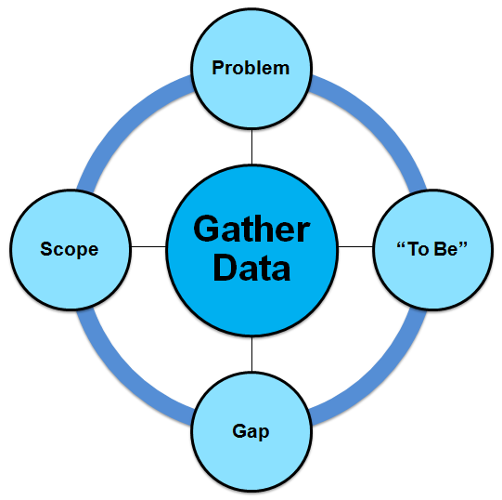
Facilitation Techniques: Discover Phase
Process Skill
Consists of establishing initial facts from an awareness of uncertainty
Foundational to process…spend ample time
Approach with inquisitive mind; be open to being surprised
Comprised of problem, “to be”, gap, scope and data gathering elements
SkillSoft. Course: Using Facilitation Skills as a Manager. ID: mgmt_31_a01_bs_enus. Skillport. Retrieved July 22, 2015, from http://library.web.boeing.com/wsso/skillsoft.asp
Notes:
Instructions:
First line and diagram visible
Each bullet appears with a mouse click
Read each statement
Say:
The Discover phase consists of establishing initial facts from an awareness of uncertainty.
This phase is foundational to the entire process. Be sure to spend ample time within this phase, since the balance of the process hinges on these first steps.
Approach the problem and solution with an inquisitive mind. Don’t pre-judge the problem or solution and be open to being surprised.
The Discover phase is comprised of the problem, the “to be” state, the gaps and the scope. Next we will examine those four components in more detail.

Slide 44
Facilitation Techniques: Discover Phase
Process Skill
Define the objectives and goals needed to ensure success
Identify limitations/exclusions
Provide clear description of issue; document current situation
Differentiate fact from opinion; don‘t make premature judgment
Identify delta between actual and desired outcome
List known obstacles
Define ideal outcome(s)
If necessary, define resource constrained outcome(s)
SkillSoft. Course: Using Facilitation Skills as a Manager. ID: mgmt_31_a01_bs_enus. Skillport. Retrieved July 22, 2015, from http://library.web.boeing.com/wsso/skillsoft.asp
Notes:
Instructions:
“Gather Data” diagram is visible
Each definition appears with a mouse click (4 mouse clicks total)
Read each bullet
Say:
As we just discussed, there are four components in the Discover phase. They are the problem statement, the ideal “to be” state, the gap(s) and the scope.
Let’s review what makes up the problem statement. Ensure that the team provides a clear description of the issue. It is imperative that the current situation is documented. When documenting this statement, do not make any premature judgments. Be sure to differentiate fact from opinion.
The next component of the Discover phase is the “to be”. This is where the team will define what the ideal outcome will be. At this time, the team can define any resource constraints.
The third component of the Discover phase is the gap. Here the team identifies the delta between the actual/desired outcome and documents any known obstacles.
The last component of the Discover phase is to define the scope. The objectives and goals of the exercise need to be clearly defined to ensure success. The team should identify any limitations and/or exclusions during this phase.

Slide 45
Facilitation Techniques: Discover Phase
Process Skill
Research articles
Utilize search engines
Find best practices
Examine culture
Dialogue with subject matter experts
Review previous attempts to solve
Notes:
Instructions:
No animation
Read each bullet
Say:
As we discussed, there are four components to the Discover phase; the identification of the problem, stating the ideal “to be”, and identifying the gap and scope. The critical piece to ensure success in the Discover phase is to continuously gather data.
The team should be mindful of all resources available for gathering data. This includes relevant research articles, utilizing search engines, finding best practices, examining the current culture, and having a dialogue with subject matter experts (SME’s). If the solution has been previously attempted, it is critical that the team review why the previous attempts to solve the problem were unsuccessful.

Slide 46

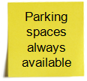
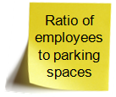

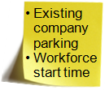
Facilitation Techniques: Sticky Note Example
Process Skill
As a team you must:
Document initial thoughts related to key components
Achieve general consensus
Problem
“To Be”
Gap
Scope
Notes:
Instructions:
First three lines are visible, along with chart
Mouse click once for sticky notes to appear. (Note: after mouse click, subsequent sticky notes will appear on timer)
Read each sticky note, with its corresponding category
Say:
Now we will review an example of the Discover process. The “sticky note” exercise is very common within the company. As a reminder, the four components of the Discover phase are the identification of the problem, stating the “to be”, identifying the gap and the scope.
As a team, you must document your initial thoughts related to these key components. Once that is complete, you will need to achieve general consensus within the team before moving on.
This is an example of how to complete the Discover process, utilizing the common “sticky note” exercise. The four components of the Discover phase are labeled. The team identifies the elements of each and puts the appropriate sticky note inside each column.
We will utilize a fictional problem, which may resonate with the class. Our problem statement has been identified as the company parking lots are full by 7:00 a.m. The ideal “to be” state would be that parking spaces are always available to the employee. The gap has been identified as the ratio of employees to parking spaces. In scope for this exercise are public bus/company shuttle systems, existing company parking and the start time of the workforce.

Slide 47
Facilitation Techniques: Common Phases of Models
Process Skill
Implement
Solve
Problem
Discover
Def ine
Select
Follow-Up
Results
Facilitation Process
Post Facilitation Process
Notes:
Instructions:
No animation
Say:
The second phase we will review within the Facilitation process is the “Define” phase.

Slide 48
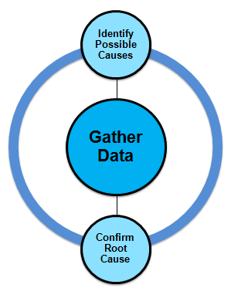
Facilitation Techniques: Define Phase
Process Skill
Ensure problem is fully understood before setting course of action
Identify possible causes
Confirm root cause
Notes:
Instructions:
First line and diagram visible
Each statement appears with a mouse click
Read each bullet
Say:
The Define phase is key to ensuring the problem is fully understood before setting upon a course of action.
First, identify all the possible causes. Next, confirm the root cause of the problem.
We will now review those two components in more detail.

Slide 49
Facilitation Techniques: Define Phase
Process Skill
Utilize observed symptoms to identify major factors contributing to problem
Identify common underlying issue causing the problem
Notes:
Instructions:
Diagram is visible
Each statement appears with a mouse click
Read each bullet
Say:
As we just discussed, there are two components to the Define phase. The first is to identify all the possible causes. Next, the team will confirm the root cause of the issue.
In order to identify the possible causes, utilize the observed symptoms to identify the major factors that are contributing to the problem.
To successfully confirm the root cause of the problem, identify the common underlying issue that is causing the problem.

Slide 50



Facilitation Techniques: Sticky Note Example
Process Skill
As a team you must:
Document possible causes for the initial problem
Possible Causes
Not enough spaces for employee population
People outside Company using lot
Too many “Reserved” spaces
Allocation of “Reserved” spaces incorrect
Virtual workers returned to site
Number of people on shifts is unbalanced
Construction crews using parking spaces
City is limiting number of spaces
Employees staying too long in spot; i.e.,overtime
Company shuttles are not adequate
Company policy of “free” parking
Product stored in parking spaces
Stall lines are incorrectly marked
Public transportation is not adequate
Notes:
Instructions:
First two lines are visible, along with possible causes chart and problem sticky note (no other sticky notes)
Mouse click once for sticky notes to appear under “possible causes”
Read a few of the sticky notes, e.g., public transportation is not adequate, too many reserved spaces, city if limiting the number of spaces, and construction crews are using employee parking spaces
Say:
This is an example of how the team can utilize the “sticky note” methodology to identify possible causes to the problem. Earlier we identified our problem of company parking lots being full by 7:00 a.m.
As a team, document all possible causes of this initial problem.
Typically, the team will place their ideas on sticky notes and post them on the wall (or large paper). In this example, some of the identified causes include: public transportation is not adequate, too many reserved spaces, city is limiting the number of spaces the company is allowed to have, and construction crews are utilizing parking spaces for storage.

Slide 51
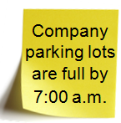
Facilitation Techniques: Cause and Effect Example
Process Skill
As a team you must:
Define major categories for grouping causes (e.g., work schedule, transportation, facilities) in order to get to root cause
Identify the causes (and sub-causes) for each category
Circle causes believed to contribute most to problem; verify through data collection
Determine if in-scope and actionable
Work Schedule
Transportation
Cause (Out of scope)
Number of people on shifts is unbalanced
Public transportation is not adequate
Actionable (In scope)
Employees staying too long in spot, i.e., overtime
Company shuttles are not adequate
Add categories as required
Virtual workers have returned on-site
Company policy of “free” parking
People outside company are utilizing lot
Product stored in parking spaces
Not enough spaces for employee population
City is limiting number of parking spaces
Allocation of “reserved” spaces incorrect
Construction crews utilizing parking spaces
Too many “reserved” spaces
Stall lines are incorrectly marked
EIS 1991
Pollution
Traffic Congestion
People
Facilities
Cause and Effect. (n.d.). Retrieved December 10, 2015, from http://leanplus.web.boeing.com/FLL/
Notes:
Instructions:
First line and four bullets are visible
Mouse click for fishbone diagram
Read each bullet
Say:
As a Facilitator, there are tools available for this problem solving phase. This is an example of a Ishikawa or Cause and Effect Diagram (a.k.a., fishbone). This template can be utilized to define the cause(s) of a problem (template available on Lean+ website). As a team, you will want to define the major categories for grouping the causes. Typical categories include people, machines, materials and methods, but in our example we utilized work schedule, transportation, people and facilities. On the right hand side, state the problem, which in our example is the company parking lots are full by 7:00 a.m.
After defining the categories, identify the causes and sub-causes for each category. For this particular example, we listed company shuttles are not adequate, construction crews and people outside our company are utilizing employee parking spaces.
Next, circle the causes believed to contribute most to the problem and continue gathering data to validate root cause.
In this example, we have determined one of the causes is the city limiting the company on the number of parking spaces allowed for employees as a result of a 1991 Environmental Impact Study. Based off our agreed upon scope in the Discover phase, this problem has been circled in red because it is out of scope.
To solve the problem, the team must identify causes that are actionable and in scope. In this example, the policy of “free” parking within the company and product is stored in employee parking spaces has been circled in green because they are actionable and in scope.

Slide 52
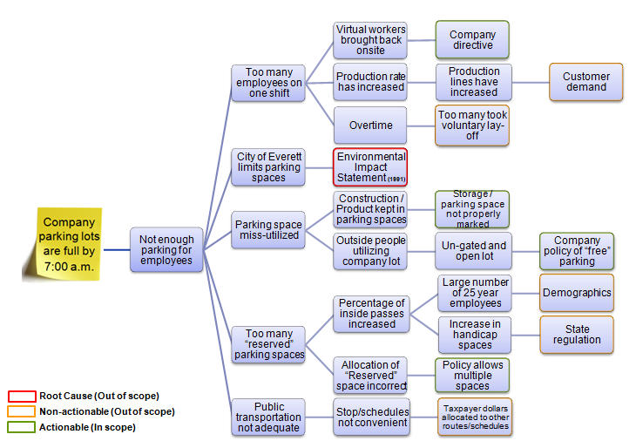
Facilitation Techniques: 5 Why’s Example
Process Skill
As a team you must:
Ask “Why” until root cause of the problem is determined
5 Whys. (n.d.). Retrieved December 10, 2015, from http://leanplus.web.boeing.com/FLL/
Notes:
Instructions:
First line and bullet are visible
Mouse click for diagram to appear
Read bullet
Say:
Another tool available to the Facilitator for problem solving is the 5 Why’s exercise (template available on Lean+ website). Again we will look at our defined problem of the company parking lots being full by 7:00 a.m.
This process requires the team to continue to ask “why” until the root cause(s) of the problem has been determined.
For example, we have stated that the lots are full by 7:00 a.m. We then ask “why” to that statement. The answer is there are not enough parking spaces for employees. Again, ask “why” this is the case. The answer to the “why” may be there are too many employees on one shift. Asking “why” again reveals virtual workers have been brought back onsite. Asking “why” again brings us to the root cause of a company directive, which in our case is circled in green because it is actionable and in scope.
As a team, continue asking this “why” process to determine all possible root causes and whether they are in/out of scope and actionable/non-actionable.

Slide 53

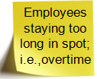
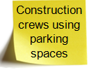

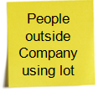

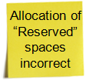
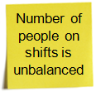
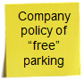
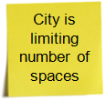
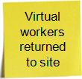
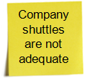
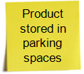
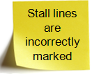
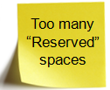
Facilitation Techniques: Sticky Note Example
Process Skill
As a team you must:
Identify root cause(s)
Root
Possible Causes
Actionable;
Out of scope
Notes:
Instructions:
First line and bullet as well as “Possible Causes” chart is visible
Mouse click for blue sticky note to appear, Actionable Out of Scope icon and red line to appear. “Root” will appear after 2 second delay
Say:
Starting with the possible causes previously identified in our “sticky note” exercise, and utilizing the fishbone or 5 Why’s tools, we can now highlight root cause(s). In this example, we determined that the company parking lots being full by 7:00 a.m. is due to the 1991 Environmental Impact Study (EIS) which limited company parking spaces to 21,000 vehicles.
Since it was a cause that was not originally determined, it is represented with a blue “sticky note”. This cause is actionable, however it is out of scope.

Slide 54
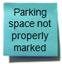
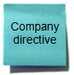
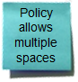
Facilitation Techniques: Sticky Note Example
Process Skill
As a team you must:
If root cause is out of scope, identify cause(s) that is/are in-scope and actionable
Actionable
Possible Causes
Actionable;
Out of scope
Actionable; In-scope
Notes:
Instructions:
First line and bullet as well as “Possible Causes” chart is visible
Mouse click for blue sticky notes to appear and Actionable In Scope icon to appear. “Actionable” will appear after 2 second delay
Say:
If the root cause of your problem is out of scope or not actionable, the team must identify root cause(s) that are in-scope and actionable. From the 5 Why’s example, there were four causes that are actionable and in-scope (circled in green): parking spaces are not properly marked, company directive, policy allows for multiple spaces and company has a policy of “free” parking.

Slide 55
Facilitation Techniques: Common Phases of Models
Process Skill
Implement
Solve
Problem
Discover
Def ine
Select
Follow-Up
Results
Facilitation Process
Post Facilitation Process
Notes:
Instructions:
No animation
Say:
The third phase we will review within the Facilitation process is the “Solve” phase.

Slide 56
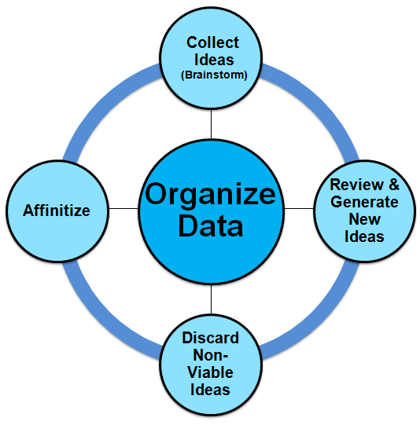
Facilitation Techniques: Solve Phase
Process Skill
Determine possible solutions that address problem
Collect as many ideas as possible (i.e., brainstorm)
Review and generate new ideas
Discard non-viable ideas
Affinitize ideas
SkillSoft. Course: Using Facilitation Skills as a Manager. ID: mgmt_31_a01_bs_enus. Skillport. Retrieved July 22, 2015, from http://library.web.boeing.com/wsso/skillsoft.asp
Notes:
Instructions:
First line and diagram are visible
Each bullet appears with a mouse click
Read each bullet
Say:
In the Solve phase, the team will determine possible solutions that will address the problem. The team should collect as many ideas as possible through the brainstorming technique. They will then review, and generate new ideas. Next, they will discard any non-viable ideas and affinitize the remaining ideas.
We will review these four components in detail now.

Slide 57
Facilitation Techniques: Solve Phase
Process Skill
Combine similar ideas into categories; delete duplicates
Record as many ideas as possible
Reserve judgment until end of process
Eliminate out-of-scope and untenable ideas
Discuss brainstormed ideas
Use synergy of discussion to generate new ideas
SkillSoft. Course: Using Facilitation Skills as a Manager. ID: mgmt_31_a01_bs_enus. Skillport. Retrieved July 22, 2015, from http://library.web.boeing.com/wsso/skillsoft.asp
Notes:
Instructions:
Diagram is visible
Each set of bullets appear with a mouse click (4 mouse clicks total)
Read each bullet
Say:
The first component within the Solve phase is the collection of ideas. Traditionally this component is referred to as “brainstorming”. The goal in this stage is to record as many ideas as possible. At this time, don’t worry about the ideas being too far fetched or out of scope. To prevent stifling idea generation, it is imperative that judgment be reserved until the end of the process (note: the vetting and discarding of ideas [if appropriate] occurs in the following components).
The second component within the Solve phase is to review and generate new ideas. As a team, discuss all brainstormed ideas to stimulate the creation of new ideas.
The third component is to discard the non-viable ideas. This is the time to eliminate any out of scope ideas, as well as any that are non-actionable or untenable.
The last component of the solve phase is to affinitize. During this stage, the team will combine similar ideas and place into appropriate categories. Any duplicate ideas should be discarded during this phase.

Slide 58
Facilitation Techniques: Solve Phase
Process Skill
Utilize tools that allow you to visualize:
List
Bar chart
Pie chart
X-Y chart
Line chart
Table
Etc...
Notes:
Instructions:
No animation
Read bullet
Say:
As we discussed, there are four components to the Solve phase; the collection of ideas or brainstorming, review and generation of new ideas, discarding of non-viable ideas and the affinitization of the ideas. At this point in the process, the team should visually organize the data, being mindful of various tools available. Some examples of these visualization tools are the bar chart, the pie chart, the line chart and the table.

Slide 59
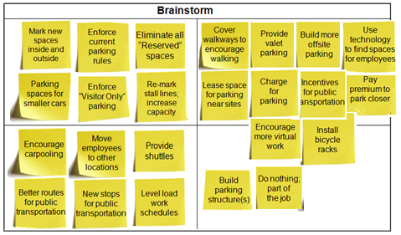
Facilitation Techniques: Sticky Note Example
Process Skill
As a team you must:
Record all information utilizing root cause² of problem; quantity, not quality is goal for this exercise
Encourage team members to further others’ ideas
Defer judgment until process is complete
² If root cause is not actionable, utilize actionable cause(s)
Notes:
Instructions:
First line, 3 bullets and template with yellow sticky notes are visible
Mouse click for the 4 causes to appear (blue sticky notes)
As you will recall, we had four potential causes of why the company parking lot was full by 7:00 a.m. If the team generates only one cause, then simply list that cause and follow the brainstorming process. Typically, the team will generate more than one potential cause for the issue. In this example, there are four potential causes to the problem of the company parking lot being full by 7:00 a.m. Since there is more than one cause, place each cause into its own quadrant. By having all causes represented on one page, it is easily visualized.
Using these four causes, the team will initiate the first component of the Solve phase, brainstorming solutions. The goal of this exercise is to collect solutions to the root causes, focusing on quantity, not quality. If necessary, encourage team members to further others’ ideas.
As previously mentioned, it is critical in this stage to defer judgment of ideas until the process is complete.

Slide 60
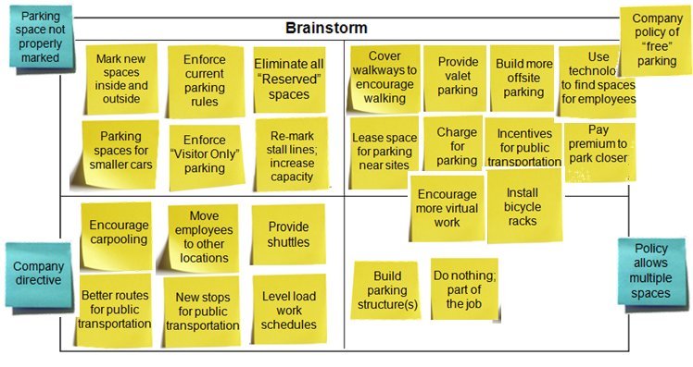


Facilitation Techniques: Sticky Note Example
Process Skill
As a team you must:
Discuss ideas
Generate new ideas
Notes:
Instructions:
First line, 2 bullets and brainstorm template visible
Mouse click for 2 new ideas on green sticky notes
Read each bullet
Say:
The next step following the brainstorm stage is to discuss all the ideas that were generated. The synergy of the discussion may generate some new ideas, which should be added to the brainstorm chart.
In the example above there are two new ideas that were generated (represented with green sticky notes): installing an arm/gate and using a badge, and changing the policy for multiple parking spots.

Slide 61
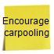


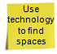
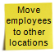
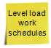
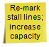
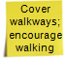
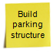





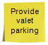
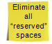
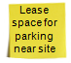


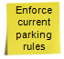
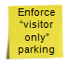
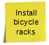
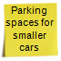
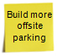
Facilitation Techniques: Sticky Note Example
Process Skill
As a team you must:
Group similar ideas
Transportation
People
Facilities
Notes:
Instructions:
First line, bullet, template and 4 sticky notes are visible
Mouse click for sticky notes to appear
Read the bullet
Say:
After the brainstorm exercise is complete, the team should then group similar ideas. At the top of the chart, the four causes of the parking lot problem are shown.
The team should decide on categories that the ideas correspond to. In this example, the team decided on the categories of Transportation, People and Facilities. As the team reviews each idea, it should be placed in the corresponding category.

Slide 62
Facilitation Techniques: Sticky Note Example
Process Skill
As a team you must:
Eliminate duplicate and non-viable ideas
Transportation
People
Facilities
Better
routes for public transport
Use technology to find spaces
Move employees to other locations
Level load work schedules
Re-mark stall lines; increase capacity
Cover walkways; encourage walking
Build parking structure
Encourage carpooling
New stops for public transport
Incentives for public transport
Require payment for parking
Do nothing; part of the job
Charge for parking
Provide valet parking
Eliminate
all “reserved” spaces
Lease
space for parking
near site
Mark new spaces in and outside
Enforce current parking rules
Enforce “visitor only” parking
Install bicycle racks
Parking spaces for smaller cars
Build more offsite parking
Encourage more virtual work
Notes:
Instructions:
First line, bullet, 4 sticky notes on top and template with sticky notes are visible
Mouse click for red “x” to to appear
Read the bullet
Say:
After the brainstormed ideas have been placed within the appropriate category, it is time to eliminate any duplicate and/or non-viable ideas.
In the example above, the team is left with four viable ideas to solve the parking lot problem. They are:
Provide shuttles
Change the policy for multiple parking spots
Pay a premium to park closer
Install a gate/arm in the parking lot and utilize a company badge.

Slide 63


Facilitation Techniques: Strengths and Weaknesses
Process Skill
As a team you must:
Record positive and negative aspects of the idea
Pro’s
Con’s
Utilizes supply and demand process
Provides opportunity to park closer
Improves odds of finding close parking
Increases employee satisfaction
Offsets increased cost to company
Increases cost (implementation/sustainment)
Decreases employee satisfaction
Eliminates non-company vehicles
Enables “pay” parking automation
Controls parking access for contract labor, vendors, suppliers
Increases “temporary” badge issues
Elevates risk for gate/arm issues
Increases cost (implementation/sustainment)
Increases employee satisfaction
Decreases administrative cost
Eliminates waste from non-utilization
Decreases employee satisfaction
Increase in space from non-utilization is minimal
Requires new justification process for multiple spots
Neutralizes distant parking inconvenience
Increased time savings
Improves safety (e.g., not walking in dark)
Increases cost (implementation/sustainment)
Decreased time savings
Increases environmental impact
Reduces Boeing on the Move activity
Notes:
Instructions:
First line, bullet and “pro” and “con” are visible
Mouse click to show the first set of pros and cons for the idea
Mouse click for the 3 remaining pros and cons for remaining ideas (4 mouse clicks total)
Read the bullet
Read a few of the pros and cons for each idea
Say:
On the previous slide, we saw that the team was left with four viable options to solve the problem of the parking lot being full by 7:00 a.m. Those ideas were to pay a premium to park closer, to install a gate/arm in the parking lot and utilize a badge, to change the policy for multiple spots and to provide shuttles.
In this portion of the Solve phase, the team begins to assess risk. In this example, the strengths and weaknesses (pro’s and con’s) of each idea are explored. The team reviews each idea and records the positive and the negative aspects of each idea.
For example, let’s take a look at the first idea of paying a premium to park closer to the work location. A pro may be that this utilizes the supply and demand process. For instance, the outer lots may be free, but the closer the employee gets to a particular location, the premium increases, to let’s say $10. This utilizes the supply and demand concept. The higher the premium, the better chance there will be available parking. Another pro may be increased employee satisfaction because paying a premium allows them to park close to their work location and not walk in the rain.
Now let’s review some of the con’s to this idea. It will increase the cost to the company for implementation (e.g., painting, signage) and sustainment (e.g., administration). In turn, it could decrease some employee satisfaction who may view this as unfair. For example, the $10 an hour worker would pay the same price as the $100 an hour worker. An example of this would be parking for the Seahawk game. If a fan wants to park close to the stadium, they can plan on paying a minimum of $50, regards of income level. The individual always has the option to pay less by parking farther away.

Slide 64
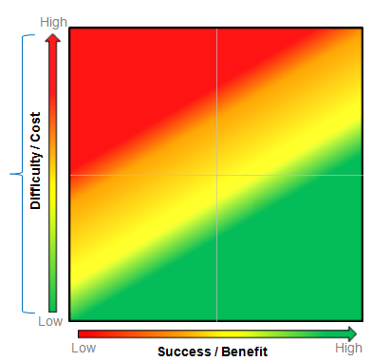
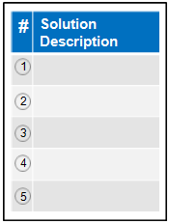
Facilitation Techniques: Solution Selection (S²) Square
Process Skill
As a team you must:
Provide solution description
Utilize axes to determine location on grid for each solution
Consider implementing idea
Discard idea
4
Provide shuttles
Pay premium
Install gate/arm and use badge
Install gate/arm
2
Change policy for multiple spots
Change policy
3
Provide shuttles
Pay premium to park closer
1
Consider implementing idea
Implement idea
Solution Selection Square. (n.d.). Retrieved December 10, 2015, from http://leanplus.web.boeing.com/FLL/
Notes:
Instructions:
First line and bullet are visible, as well as the Solution Description box
Read bullet
Mouse click for second bullet and chart to appear
Read bullet
Mouse click for sticky notes to be visible on risk square
Say:
This is another example of assessing risk on a chosen solution (template is available through the Lean+ website). The risk cube utilizes a Y-axis that depicts the difficulty/cost ranging from low to high and an X-axis that depicts the success/benefit from low to high. The grid has four quadrants in which the team will assess the solutions:
Bottom left quadrant of the grid shows a low difficulty/cost (Y-axis) and low success/benefit (X-axis)
Bottom right quadrant of the grid shows a low difficulty/cost (Y-axis) and high success/benefit (X-axis)
Top left quadrant of the grid shows a high difficulty/cost (Y-axis) and low success/benefit (X-axis)
Top right quadrant of the grid shows a high difficulty/cost (Y-axis) and high success/benefit (X-axis)
The grid also has three color bands that can be used to help the team assess solution risk:
Green band: Implement idea
Yellow band: Consider implementing idea
Red band: Discard idea
The first step for the team is to number the solutions by inputting them into the Solution Description box. The second step is to utilize the axes to determine the placement of the solution on Solution Selection Square.
Our first solution is to pay a premium to park. The team decided the difficulty/cost (Y-axis) was low, and the success/benefit (X-axis) was medium. The result of this placement fell within the green band, which means the team should implement this idea.
The second solution is to install a gate/arm and utilize a badge to park. The team decided the difficulty/cost (Y-axis) was low, and the success/benefit (X-axis) was high. The result of this placement fell within the green band, which means the team should implement this idea.
The third solution is to change the policy regarding multiple parking spaces. The team decided the difficulty/cost (Y-axis) was medium, and the success/benefit (X-axis) was medium. The result of this placement fell within the yellow band, which means the team should consider implementing this idea.
The fourth solution is to provide shuttles. The team decided the difficulty/cost (Y-axis) was high, and the success/benefit (X-axis) was medium. The result of this placement fell within the red band, which means the team should discard this idea.

Slide 65
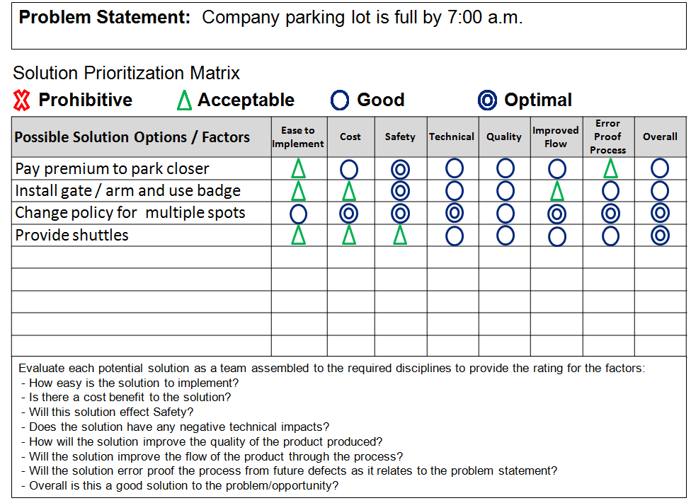
Facilitation Techniques: Solution Prioritization Matrix
Process Skill
As a team you must:
Identify proposed solutions and evaluate against each factor
Assign rating to each solution
Solution Prioritization Matrix. (n.d.). Retrieved December 10, 2015, from http://leanplus.web.boeing.com/FLL/
Notes:
Instructions:
First line and 2 bullets are visible
Read bullets
Mouse click for chart to appear
Say:
The solution prioritization matrix (template available on the Lean+ website) is another tool that may be utilized to assess risk. The team documents proposed solutions, evaluates against various factors and assigns ratings to each solution.
In this example, the four viable solutions are placed on the matrix. Looking at the first solution, paying a premium to park closer, the team marked it “acceptable” on ease of implementation and error proofing; “good” on cost, technical, quality and improved flow; and “optimal” for safety. Overall, the team scored it “good”.
To further illustrate the use of this template, let’s review the fourth solution of providing shuttles. The team rated this idea as “acceptable” on the ease to implement, cost and safety and “good” under the technical, quality, improved flow, and error proof process categories. Overall, the team assigned an “optimal” rating to this solution.

Slide 66
Facilitation Techniques: Multi-Voting Example
Process Skill
As a team you must:
Calculate the number of votes each team member will receive (i.e., one third of total population or set number)
Generate a list of options
Vote for desired choice based on agreed to criteria
Vote
Options
Team Members
Celeste …..
Dave ……..
Diana …….
Nancy …....
Joseph …..
Mike ………
Cindy ……..
Maryann ….
Solutions to Parking Lot Issue
1. Pay premium to park closer
2. Install gate/arm and use badge
3. Change policy for multiple parking spots
4. Provide shuttles
Multi-Voting. (n.d.). Retrieved December 10, 2015, from http://leanplus.web.boeing.com/FLL/
Notes:
Instructions:
First line and first bullet are visible
Mouse click for second bullet and Options chart to appear
Mouse click for third bullet and Vote chart to appear
Read each bullet
Say:
This is an example of a multi-vote technique (template available through the Lean+ website). Here, the team calculates the number of votes that each team member will receive. Typically, one-third of the total population of the team members is utilized (e.g., 9 members would receive 3 votes each), or a set number. Next, the team designates a number for each solution and lists it in options box. Then the team will place their vote for his/her choice based on agreed to criteria.

Slide 67
Facilitation Techniques: Common Phases of Models
Process Skill
Implement
Solve
Problem
Discover
Def ine
Select
Follow-Up
Results
Facilitation Process
Post Facilitation Process
Notes:
Instructions:
No animation
Say:
The fourth and final phase we will review within the Facilitation process is the “Select” phase.

Slide 68
Facilitation Techniques: Select Phase
Process Skill
Select solution that is most effective in solving the problem
Identify solution selection process
Evaluate solution risks
Select solution
Share selected solution
Notes:
Instructions:
Fist line and diagram visible
Mouse click for each bullet
Read each bullet
Say:
In the Select phase, the solution is selected that most effectively solves the original problem. In this phase, the team will identify the solution selection process, evaluate the solution risks, select the solution and finally share the selected solution.
We will review these four components in detail now.

Slide 69
Facilitation Techniques: Select Phase
Process Skill
Communicate decision and results
Craft recommendation statement (if applicable)
Identify decision making authority of team:
None
Provide data to decision maker
Process ends
Recommendation only or Decide
Choose methodology to select solution (e.g., vote, data driven)
Dialogue on solutions:
Strengths and weakness
Cost/benefit
Level of risk
Team members draw own conclusions
Implement process to select solution (e.g., vote, data driven)
Notes:
Instructions:
Diagram is visible
Mouse click for each set of bullets (4 total)
Read bullets
Say:
As we discussed, there are four components to the Select phase. The first step in this phase is to identify the solution selection process. This means the decision making authority of the team must be identified. If the team does not have the authority to make the final decision, then they will need to provide the data to the decision maker. In turn, the process will end, meaning they will not continue with the other three components noted here.
If the team has the authority to make a recommendation only or decide, they will need to choose the methodology to select the solution. This could be data driven, or through a vote, etc…
The next step in this phase is to evaluate the solution risks. The team dialogue on the solutions should utilize analysis tools such as strengths and weaknesses (pro’s and con’s), cost/benefit analysis and level of risk. During this phase, each member draws their own conclusion on the most viable solution.
The third component is the selection of the solution. The team will implement the agreed to selection process (e.g., vote, data driven).
Finally, the team will share the selected solution. The team is responsible for communicating the decision and results. If applicable, they will also craft a recommendation statement for the preferred solution.

Slide 70
Facilitation Techniques: Select Phase
Process Skill
Review and discuss data
Note logical trends/patterns
Weigh conclusions based on risk
Notes:
Instructions:
No animation
Read each bullet
Say:
As we discussed, there are four components to the Select phase: to identify the solution selection process, to evaluate the solution risks, to select the solution and finally to share the selected solution. At this point in the process, the team should analyze the data that has been gathered.
This entails the team reviewing and discussing the data they have gathered, noting logical trends and patterns, and weighing conclusions based on the risk.

Slide 71
Facilitation Techniques: Solution Selection (S²) Square
Process Skill
As a team you must:
Provide solution description
Utilize axes to determine location on grid for each solution
Consider implementing idea
Discard idea
4
Provide shuttles
Pay premium
Install gate/arm and use badge
Install gate/arm
2
Change policy for multiple spots
Change policy
3
Provide shuttles
Pay premium to park closer
1
Consider implementing idea
Implement idea
Solution Selection Square. (n.d.). Retrieved December 10, 2015, from http://leanplus.web.boeing.com/FLL/
Notes:
Instructions:
No animation
Say:
In this example, the team has decided to utilize the Solution Selection square color-banding to determine which solution(s) to implement. In this case, that would be #1 to pay premium to park closer and #3 to change policy for multiple spots.

Slide 72
Facilitation Techniques: Solution Prioritization Matrix
Process Skill
As a team you must:
Identify proposed solutions and evaluate against each factor
Assign rating to each solution
Solution Prioritization Matrix. (n.d.). Retrieved December 10, 2015, from http://leanplus.web.boeing.com/FLL/
Notes:
Instructions:
No animation
Say:
In this example, the team has decided to utilize the Solution Prioritization matrix to determine which solution(s) to implement. In this case, the change policy for multiple spots received 6 optimal and 2 good ratings making it the preferred solution.

Slide 73
Facilitation Techniques: Multi-Voting Example
Process Skill
As a team you must:
Calculate the number of votes each team member will receive (i.e., one third of total population or set number)
Generate a list of options
Vote for desired choice based on agreed to criteria
Vote
Options
Team Members
Celeste …..
Dave ……..
Diana …….
Nancy …....
Joseph …..
Mike ………
Cindy ……..
Maryann ….
Solutions to Parking Lot Issue
1. Pay premium to park closer
2. Install gate/arm and use badge
3. Change policy for multiple spots
4. Provide shuttles
Multi-Voting. (n.d.). Retrieved December 10, 2015, from http://leanplus.web.boeing.com/FLL/
Notes:
Instructions:
First line and two bullets are visible, as well as options chart
Mouse click to bring up third bullet and Vote chart
Say:
In this example, the team has decided to utilize the Multi-Voting method to determine which solution(s) to implement. In this case, providing shuttles received the majority of the votes making it the preferred solution.
As you may have noticed, each tool resulted in a different preferred solution. As a Facilitator, it is recommended you utilize multiple tools to assess as many facets and risks as possible, which increases the odds of identifying the preferred solution.

Slide 74
Facilitation Techniques: What Did You Learn?
Notes:
Instructions:
Read each question
Mouse click to reveal the answers to choose from
Group chooses the appropriate answer(s)
Mouse click to show the answer
Say:
Knowledge Check

Slide 75
Facilitation Techniques: What Did You Learn?
Question:
There are various problem solving frameworks that can be utilized to solve a problem. If necessary, a Facilitator may use the generic problem solving framework which encompasses the model, phases and steps. What are the four phases of this common framework?
Choose the best option.
Identification, Evaluation, Selection and Implementation
Discover, Define, Solve and Select
Define, Root Cause, Select and Sustain
Define, Solve, Select and Implement
Answer: #2
Notes:
Instructions:
Read the question
Potential answers appear on mouse click
Answer appears on mouse click
Say:
Question: There are various problem solving frameworks that can be utilized to solve a problem. If necessary, a Facilitator can use the generic problem solving framework which encompasses the model, phases and the steps within each phase. What are the four phases of this common framework?
[mouse click]
Choose the best option.
Identification, Evaluation, Selection and Implementation
Discover, Define, Solve and Select
Define, Root Cause, Select and Sustain
Define, Solve, Select and Implement
Answer:
#2-Discover, Define, Solve and Select
Allowing group discussion is optional

Slide 76
Facilitation Techniques: What Did You Learn?
Question:
One of the essential techniques of the “Solve” phase is to brainstorm ideas. Which one of these factors is not a part of the brainstorming process?
Choose the best option.
Record all information utilizing root cause of the problem
Quality of the ideas is the goal for brainstorming exercise, not the quantity
Encourage team members to further others’ ideas
Group similar ideas into categories
Defer judgment of ideas until the process is complete
Answer: #2
Notes:
Instructions:
Read the question
Potential answers appear on mouse click
Answer appears on mouse click
Say:
Question: One of the essential techniques of the “Solve” phase is to brainstorm ideas. Which one of these factors is not a part of the brainstorming process?
[mouse click]
Choose the best option.
Record all information utilizing root cause of the problem
Quality of the ideas is the goal for brainstorming exercise, not the quantity
Encourage team members to further others’ ideas
Group similar ideas into categories
Defer judgment of ideas until the process is complete
Answer:
#2-Quality of the ideas is the goal for brainstorming exercise, not the quantity
Allowing group discussion is optional

Slide 77
Facilitation Techniques: Common Phases of Models
Process Skill
Implement
Solve
Problem
Discover
Def ine
Select
Follow-Up
Results
Facilitation Process
Post Facilitation Process
Notes:
Instructions:
No animation
Say:
This concludes the “process” skills necessary for good Facilitation. We discovered how a team identifies a problem, and the phases and steps that must be taken in order to achieve a successful result.
The team will also be responsible for Implementation and Follow-up to the solution; however, these last two phases are post Facilitation processes and are not part of this Facilitation module.
As previously stated, a successful Facilitator needs to possess both process skills and people skills. We will now cover the second area…people skills.

Slide 78
Facilitation Techniques: Common Phases of Models
C
R
M
H
Implement
W
Solve
Problem
Discover
K
Def ine
Select
Follow-Up
Results
Facilitation Process
Post Facilitation Process
C= Complainer H= Homesteader
W= Windbag R= Rambler
M= Mummy K= Know-It-All
Notes:
Instructions:
No animation
Say:
This portion of the Facilitation module will focus on the “people” skills necessary for successful Facilitation. It is crucial that you have a healthy balance between process and people skills. If you master the process, but ignore the people aspect, you will not be a successful Facilitator. The individuals on the team must work with each other to solve the problem – not against each other.

Slide 79
Facilitation Techniques: Skills of Successful Facilitator
“Process” Skills:
Problem Solving Model: Recognize/utilize methodology to resolve issue
Problem Solving Phase: Identify/explain phases to resolve issue
Problem Solving Step: Identify/explain/guide team to resolve issue
“People” Skills:
Active Listening: Demonstrating interest by your body language
Building Rapport: Establishing credibility to enable people to contribute with ease
Communicating Effectively: Being supportive and engaged to enable an open and safe environment
Questioning Techniques: Utilizing questions to check understanding, ask for clarification or expand a view
W
M
Must Master Both Skills To Be Successful!
Notes:
Instructions:
No animation
Say:
As we have discussed, both process and people skills are necessary to become a successful Facilitator. We will now focus on the following people skills:
Active Listening: Demonstrating interest by your body language
Building Rapport: Establishing credibility to enable people to contribute with ease
Communicating Effectively: Being supportive and engaged to enable an open and safe environment
Questioning Techniques: Utilizing questions to check understanding, ask for clarification or to expand a view
You must master both skills in order to be successful!

Slide 80
Facilitation Techniques: Dysfunctional Team Behaviors
People Skill
Does not freely voice opinion
No participation due to: indifference, inferiority complex, confusion on issue or feeling of superiority
Voices pre-conceived position
Highly reluctant to budge or consider other viable alternatives
M
Mummy
H
Homesteader
The Mummy
The Homesteader
Voices comments too frequently
Tends to dominate discussion
Likely the first to speak on issue
C
Voices negative aspects of situation
Pessimistic attitude fueled by anger
Looking for sympathy, not resolution
W
Windbag
Complainer
The Windbag
The Complainer
Voices remarks that are off track
Misses the point
Uses far-fetched examples to make a point
K
Voices opinion with attitude of superiority
Judgmental of ideas, individuals and team
R
Know-It-All
Rambler
The Rambler
The Know-It-All
Facilitation Skills - Developing Facilitative Leadership. (n.d.). Retrieved December 17, 2015, from http://ilj.org/publications/docs/Facilitation_Skills_Developing_Facilitative_Leadership.pdf
Notes:
Instructions:
The “Mummy” and definition are visible
Mouse click for each of the other types of team members (5 mouse clicks total)
Read each bullet
Say:
While being part of a team, there are some common types of dysfunctional behaviors that are typically encountered. We will first review the types of team behaviors and their attributes, and then discuss how to address each of these.
The “Mummy” does not freely voice their opinion. There are many reasons why they may not actively participate within the group. It may be due to indifference, they may have an inferiority complex, they may be confused about the problem, or they may have a feeling of superiority.
The “Homesteader” voices their pre-conceived position on the problem. They are highly reluctant to change their initial position, even when hearing other facts. They tend to not budge or consider other viable alternatives that are presented.
The “Windbag” voices comments too frequently. They tend to dominate the entire discussion, and they are the ones most likely to speak first on the issue at hand.
The “Complainer” voices negative aspects of the situation. Their pessimistic attitude may be fuelled by anger. The “Complainer” is typically not looking for resolution, they tend to seek sympathy.
The “Rambler” voices remarks that are completely off track. They tend to miss the point, and use far-fetched examples to try and make their point.
The “Know-It-All” voices their opinion with an attitude of superiority. They are typically judgmental of ideas, as well as individuals and the team.

Slide 81
Facilitation Techniques: Dysfunctional Team Behaviors
People Skill
Address these team members by…
W
Limiting Their
Comments
The Windbag
H
Targeting Questions
To Others
R
The Homesteader
The Rambler
Not Assigning As
Sub-Group Facilitators
K
C
The Know-It-All
Being Patient
The Complainer
Facilitation Skills - Developing Facilitative Leadership. (n.d.). Retrieved December 17, 2015, from http://ilj.org/publications/docs/Facilitation_Skills_Developing_Facilitative_Leadership.pdf
Notes:
Instructions:
The left hand side of slide is visible
Mouse click for each solution (4 mouse clicks total)
Read each statement
Say:
There are techniques that can be utilized as Facilitators to address these dysfunctional team behaviors. Specifically, the “Windbag”, “Homesteader”, “Rambler” and “Know-It-All” behaviors can be addressed by:
Limiting their comments (e.g., “thank you for your comment, let’s hear what the rest of the team has to say…”)
Purposefully target questions to other members of the team
Not assign as sub-group Facilitators
Being patient

Slide 82
Facilitation Techniques: Dysfunctional Team Behaviors
People Skill
Address this team member by…
Encouraging Their Comments
M
Targeting Questions
To Them
The Mummy
Assigning As
Sub-Group Facilitators
Being Patient
Facilitation Skills - Developing Facilitative Leadership. (n.d.). Retrieved December 17, 2015, from http://ilj.org/publications/docs/Facilitation_Skills_Developing_Facilitative_Leadership.pdf
Notes:
Instructions:
No animation
Say:
In the previous slide we saw how we could address five types of dysfunctional team behaviors. The only missing behavior was the “Mummy”, who must be addressed differently by:
Encouraging their comments (e.g., “We’ve heard from all of the team except for Jim. Jim, what do you think?”)
Target questions directly to them…especially if you know they are an expert in a particular area
Assign them as sub-group Facilitators because it requires them to integrate with the team
Be patient
As you notice, except for being patient, the techniques to address the “Mummy” behaviors are exactly the opposite of the other five behaviors.

Slide 83
Facilitation Techniques: Enabling Team Dialogue
People Skill
Utilize active listening to keep group focused and on topic
Recognize progress the team has made
Model behavior; avoid judgment
Utilize when someone has made an error or is jumping to wrong conclusion
“What are you basing your conclusion on?”
Guide
Probe
Utilize when unsure of the point the participant is trying to make
“Help me here…how does this point relate to the discussion?”
Utilize to steer a conversation back on track
“I understand your point. Since we are discussing something else, can we table that for now?”
Clarify
Redirect
Utilize when seeking other solutions or as a prompt if discussion has stalled
“Are there any other areas the group hasn’t considered?”
No Intervention
Scan and observe participation
Watch non-verbal cues
Don’t overreact; ignore isolated moments of non-productive behavior
Challenge
Utilize to verify your understanding, and share with group
“As I understand it, you’re saying that the third option is more economical. Is that correct?”
Take time to address any emotional issues
If meeting is stalled; collect thoughts and re-focus the team
Take a
Break
Confirm
SkillSoft. Course: Challenges of Facilitating. ID: mgmt_31_a03_bs_enus. Skillport. Retrieved July 27, 2015, from http://library.web.boeing.com/wsso/skillsoft.asp
Notes:
Instructions:
8 mouse clicks total
Mouse click for each solution to enable team dialogue
Read each bullet
Say:
There are techniques that the Facilitator needs to utilize in order to enable dialogue amongst the team. Let’s review when to utilize particular techniques in a situation, and some examples.
The “Guide” technique, setting a good example, is the most important behavior a Facilitator possesses to enable team dialogue. Because you are asking the team to model proper behaviors, you as their guide and Facilitator must set a higher standard (e.g., don’t take the team off topic, don’t interrupt someone speaking, don’t judge).
The Facilitator may need to “Clarify”. Utilize this technique when unsure of the point a participant is trying to make. Say something like “Help me here…how did this point relate to the discussion?”
The “Challenge” technique can be utilized when the team has stalled. Utilize this technique to prompt discussion or when attempting to seek other solutions. As the Facilitator, say “Are there any other ideas that the group has not yet considered?”
The “Confirm” technique can be used to verify your understanding, as well as the entire group, of what was stated by a team member. As an example of this technique, state something like “As I understand it, you’re saying the third option is more economical. Is that correct?”
The “Probe” technique can be utilized by the Facilitator to enable team dialogue. Use this technique when someone has made an error, or has jumped to the wrong conclusion. When this occurs, state something like “What are you basing your conclusion on?”
It may be appropriate at times for the Facilitator to “Redirect”. This technique is utilized to steer a conversation back on track if a non-productive behavior continues beyond a reasonable amount of time. State something like “I understand your point. Since we are discussing something else at this time, can we table that for now?”
There may be times when “No Intervention” is warranted. As a skilled Facilitator, continuously scan and observe participation within the team. Watch for body language and non-verbal cues. There may be moments of non-productive behavior, or off track conversation. Don’t overreact and/or feel the need to intervene.
There may also be times when it is appropriate for the team to “Take a Break”. If the meeting is stalled, taking a break can help the team re-focus and collect their thoughts. Sometimes the meeting can become heated, and taking a break allows you to address any emotional issues.

Slide 84
Facilitation Techniques: Video
Video: Intervening Appropriately – Intervening, 1 minute
Discussion questions:
How did Roger appropriately intervene to help Anna?
SkillSoft. Course: Using Facilitation Skills as a Manager. ID: mgmt_31_a01_bs_enus. Skillport. Retrieved July 27, 2015, from http://library.web.boeing.com/wsso/skillsoft.asp
Notes:
Instructions:
Show video on page 26 of “Intervening Appropriately” topic. Use discussion questions to discuss afterwards. Discussion questions appear on mouse click.
How did Roger appropriately intervene to help Anna? Roger asked Anna to confirm that his statement about a lack of data was correct. He also mentioned that here could be other issues, such as a distribution problem. He noted the agreement to back up assertions with facts.
Say:
Now we are going to view a short video focused on appropriate intervention. We will have discussion afterward.
How did Roger appropriately intervene to help Anna?

Slide 85
Facilitation Techniques: Video
Video: Using Questions Effectively – Introduction, 1 minute
Discussion questions:
Why do you think Lee and Jason had difficulty responding to Mina’s questions?
SkillSoft. Course: Using Facilitation Skills as a Manager. ID: mgmt_31_a01_bs_enus. Skillport. Retrieved July 28, 2015, from http://library.web.boeing.com/wsso/skillsoft.asp
Notes:
Instructions:
Show video on page 2 of “Using Questions Effectively” under “Introduction” topic. Use discussion questions to discuss afterwards. Discussion questions appear on mouse click.
Why do you think Lee and Jason had difficulty responding to Mina’s questions? Mina tried to be inclusive and encouraging, but clearly she wasn’t very successful in engaging her team in the meeting. It is not about giving them the right answers, but rather asking the right type of questions. Facilitative questions are also known as Socratic questioning. This type of questioning enables people to answer own their own question. This can help guide people to find their own solutions. Successful facilitators utilize this type of questioning to stimulate people to identify their own solution. Better questions = better answers.
Say:
Now we are going to view a short video focused on utilizing questions effectively. We will have discussion afterward.
Why do you think Lee and Jason had difficulty responding to Mina’s questions?

Slide 86
Facilitation Techniques: Video
Video: Using Questions Effectively – Effective Facilitation, 1 minute
Discussion questions:
What techniques did Mina utilize during this meeting to ensure a more productive meeting?
SkillSoft. Course: Using Facilitation Skills as a Manager. ID: mgmt_31_a01_bs_enus. Skillport. Retrieved July 28, 2015, from http://library.web.boeing.com/wsso/skillsoft.asp
Notes:
Instructions:
Show video on page 17 “Using Questions Effectively” under “Introduction” topic. Use discussion questions to discuss afterwards. Discussion questions appear on mouse click.
What techniques did Mina utilize during this meeting to ensure a more productive meeting? Mina’s initial conversation with her team did not go well. Her second meeting was more productive, since she had time to study up on how to utilize the right questions to facilitate an effective discussion. Mina used image building phases, and open-ended questions to encourage replies. Mina effectively utilized response questions. She used a confirming response to sum up the views of Lee and Jason. She also used a clarifying question to get Lee to explain her point. Mina used a probing response to get meeting participants to focus in on the objective.
Say:
Now we are going to view a short video focused on utilizing questions effectively. We will have discussion afterward.
What techniques did Mina utilize during this meeting to ensure a more productive meeting?

Slide 87
Facilitation Techniques: What Did You Learn?
Knowledge Check questions are from Skillport. Using Facilitation Skills as a Manager. Retrieved July 28, 2015.
Notes:
Instructions:
Read each question
Mouse click to reveal the answers to choose from
Group chooses the appropriate answer(s)
Mouse click to show the answer
Say:
Knowledge Check

Slide 88
Facilitation Techniques: What Did You Learn?
Question:
As the Facilitator, you encounter two team members who are displaying “Windbag” and “Know-It-All” behaviors. Which examples illustrate how to effectively address this type of behavior:
Choose more than one option.
Limit the amount of time you allow them to speak
Target questions to other members of the team
Encourage the comments that they make
Assign them as your sub-group facilitators
Be patient
Answer: #1, #2, #5
Notes:
Instructions:
Read the question
Potential answers appear on mouse click
Answer appears on mouse click
Say:
Question: As a Facilitator, you encounter two team members who are displaying “Windbag” and “Know-It-All” behaviors. Which examples illustrate how to effectively address this type of behavior:
[mouse click]
Choose more than one option.
Limit the amount of time you allow them to speak
Target questions to other members of the team
Encourage the comments that they make
Assign them as your sub-group facilitators
Be patient
Answer:
#1-Limit the amount of time you allow them to speak
#2-Target questions to other members of the team
#5-Be patient
Allowing group discussion is optional

Slide 89
Facilitation Techniques: What Did You Learn?
Question:
As the Facilitator, what are some effective techniques you can utilize to enable team dialogue?
Choose more than one option.
Ask a clarifying question, such as “Help me understand…how does this relate to our discussion?”
Redirect the team if the conversation goes off course, such as “I understand your point. Since we are discussing another topic, can we table that for now?”
Have the team take a break if the meeting has stalled, or you need to address any emotional issues
Challenge the team when the meeting has stalled or you know there are other solutions to an issue, such as “Are there any other ideas that the group has not yet considered?”
Intervene immediately if you hear an off-topic response
Answer: #1, #2, #3, #4
Notes:
Instructions:
Read the question
Potential answers appear on mouse click
Answer appears on mouse click
Say:
Question: As the Facilitator, what are some effective techniques you can utilize to enable the team dialogue?
[mouse click]
Choose more than one option.
Ask a clarifying question, such as “Help me understand…how does this relate to our discussion?”
Redirect the team if the conversation goes off course, such as “I understand your point. Since we are discussing another topic, can we table that for now?”
Have the team take a break if the meeting has stalled, or you need to address any emotional issues
Challenge the team when the meeting has stalled or you know there are other solutions to an issue, such as “Are there any other ideas that the group has not yet considered?”
Intervene immediately if you hear an off-topic response
Answer:
#1-Ask a clarifying question, such as “Help me understand…how does this relate to our discussion?”
#2-Redirect the team if the conversation goes off course, such as “I understand your point. Since we are discussing another topic, can we table that for now?”
#3-Have the team take a break if the meeting has stalled, or you need to address any emotional issues
#4-Challenge the team when the meeting has stalled or you know there are other solutions to an issue, such as “Are there any other ideas that the group has not yet considered?”
Allowing group discussion is optional

Slide 90
Facilitation Techniques: Skills of Successful Facilitator
“Process” Skills:
Problem Solving Model: Recognize/utilize methodology to resolve issue
Problem Solving Phase: Identify/explain phases to resolve issue
Problem Solving Step: Identify/explain/guide team to resolve issue
“People” Skills:
Active Listening: Demonstrating interest by your body language
Building Rapport: Establishing credibility to enable people to contribute with ease
Communicating Effectively: Being supportive and engaged to enable an open and safe environment
Questioning Techniques: Utilizing questions to check understanding, ask for clarification or expand a view
W
M
Must Master Both Skills To Be Successful!
Notes:
Instructions:
No animation
Say:
As we have discussed, there are skills necessary to become a successful Facilitator. This involves both “process” and “people” skills. As a review:
“Process Skills”:
Problem Solving Model: Recognize/utilize methodology to resolve issue
Problem Solving Phase: Identify/explain phases to resolve issue
Problem Solving Step: Identify/explain/guide team to resolve issue
“People Skills”:
Active Listening: Demonstrating interest by your body language
Building Rapport: Establishing credibility to enable people to contribute with ease
Communicating Effectively: Being supportive and engaged to enable an open and safe environment
Questioning Techniques: Utilizing questions to check understanding, ask for clarification or to expand a view
You must master both skills in order to be successful!

Slide 91
Facilitation Techniques: Common Phases of Models
C
R
M
H
Implement
W
Solve
Problem
Discover
K
Def ine
Select
Follow-Up
Results
Facilitation Process
Post Facilitation Process
C= Complainer H= Homesteader
W= Windbag R= Rambler
M= Mummy K= Know-It-All
Notes:
Instructions:
No animation
Say:
We have reviewed types of dysfunctional team behaviors, and shown how a Facilitator can overcome those obstacles.
The picture that is shown depicts an ideal state and not what you as the Facilitator would normally encounter.

Slide 92
Facilitation Techniques: Common Phases of Models
Typically, you will find missing phases (gears), steps (teeth) and people working against each other…
C
H
W
R
Implement
K
Solve
Problem
Discover
Def ine
Follow-Up
Results
Facilitation Process
Post Facilitation Process
C= Complainer H= Homesteader
W= Windbag R= Rambler
M= Mummy K= Know-It-All
Notes:
Instructions:
No animation
Say:
This picture depicts an example of what you as a Facilitator may encounter:
Missing phases (gears) and steps (teeth)
People working against each other
A Facilitator that possesses the necessary process and people skills will be able to successfully diagnose:
Missing process phases/steps and supply a path forward
People working against each other and correct the behavior

Slide 93
Facilitation Techniques: Common Phases of Models
Ideally, you develop the necessary skills to facilitate an efficient process that enables people to effectively work together…
Implement
Solve
Problem
Discover
Def ine
Select
Follow-Up
Results
Facilitation Process
Post Facilitation Process
Notes:
Instructions:
No animation
Say:
If done correctly, the Facilitator will help create an efficient process, enabling people to work effectively together.
Notice:
Gears (phase) of the process are all in place as well as there are no missing steps (teeth)
People in this picture no longer have the letters on them, i.e., “W” for Windbag, but are all working together for the collective good

Slide 94
Review
Review
Notes:
Instructions:
No animation
Say: Review

Slide 95
Facilitation: Review
Explain the purpose and benefits
Recognize when to use
Describe common mistakes
Apply effective techniques
Notes:
Instructions:
4 Objectives total
First objective is visible
Mouse click for subsequent objectives to appear and read the objectives
Say: The objectives for this module are:
Explain the purpose and benefits
Recognize when to use
Describe common mistakes
Apply effective techniques
At the beginning of this module, we asked the question “When you think of Facilitation, who comes to mind?” You now understand the importance of possessing both process and people skills for successful Facilitation, and that it is a tool that should be in your leadership toolbox.

Slide 96
References
References

Slide 97
Facilitation: References
Skillport Course – requires Skillport login first https://boeing.skillport.com
Using Facilitation Skills as a Manager. (Search for: mgmt_31_a01_bs_enus)
Challenges of Facilitating. (Search for: mgmt_31_a03_bs_enus)
Skill Brief:
Addressing Behavior That May Impede Progress. SkillBrief. Course: Challenges of Facilitating. Search for: mgmt_31_a03_bs_enus_sbmgmt_31_a03_bs_enus002003. Skillport. Web. Accessed December 11, 2015.
Intervening. SkillBrief. Course: Using Facilitation Skills as a Manager. Search for: mgmt_31_a01_bs_enus_sbmgmt_31_a01_bs_enus002005. Skillport. Web. Accessed December 6, 2015.
Responding To Objections. Skillbrief. Course: Challenges of Facilitating. Search for: mgmt_31_a03_bs_enus_sbmgmt_31_a03_bs_enus002005. Skillport. Web. Accessed December 14, 2015.
Facilitative Balance. Skillbrief. Course: Facilitative Fundamentals: Tools and Techniques. Search for: mgmt_31_a03_bs_enus_sbmgmt_31_a03_bs_enus002005. Skillport. Web. Accessed December 14, 2015.
Facilitative Approach. SkillBrief. Course: Using Facilitation Skills as a Manager. Search for: mgmt_31_a01_bs_enus_sbmgmt_31_a01_bs_enus002005. Skillport. Web. Accessed December 6, 2015.

Slide 98
Facilitation: References
Job Aid:
Using Observation Skills to Diagnose Behavior. Job Aid. Course: Using Facilitation Skills as a Manager. Search for: mgmt_31_a01_bs_enus_jamgmt_31_a01_bs_enust501. Skillport. Web. Accessed December 14, 2015. (https://boeing.skillport.com/)
Effective Type of Questions for Facilitation. Job Aid. Course: Using Facilitation Skills as a Manager. Search for: mgmt_31_a01_bs_enus_jamgmt_31_a01_bs_enust701. Skillport. Web. Accessed December 14, 2015. (https://boeing.skillport.com/)
How to Share Observations. Job Aid. Course: Using Facilitation Skills as a Manager. Search for: mgmt_31_a01_bs_enus_jamgmt_31_a01_bs_enust502. Skillport. Web. Accessed December 14, 2015
Guidelines for Preventing Dysfunctional Behaviors. Job Aid. Course: Challenges of Facilitating. Search for: mgmt_31_a01_bs_enus_jamgmt_31_a01_bs_enust301. Skillport. Web. Accessed December 14, 2015. (https://boeing.skillport.com/)
Facilitating Productive Conflict. Job Aid. Course: Challenges of Facilitating. Search for: mgmt_31_a03_bs_enus_jamgmt_31_a03_bs_enust701. Skillport. Web. Accessed December 14, 2015. (https://boeing.skillport.com/)

